Slide 1
Data Analysis Boot Camp
29400M_7.0_2017
Notes:
INSTRUCTOR NOTES
Welcome students and take time to let them introduce themselves. When the class is an open class, the backgrounds of the students will help define examples for the rest of the class that will speak to them individually.

Slide 2
Introduction
What we will cover
Data: How we get it, how we manage it
Basics of Probability and Statistics
Numerical and Visual Modelling
Prediction
Telling the Story
Notes:
This class discusses data as it is in the real world. When analyzing any data, the first step is to get data. Very often these come from external sources and will require extensive methods to evaluate, clean, store and manage. Once that data is “in house” a variety of techniques can be applied to extract information from the data you have managed to collect. All of this starts with a basic understanding of probability and statistics. Analysis techniques applied to data in the real world are very often statistical in nature for the simple reason that the world is a complex place. We don’t know many “textbook” equations that we can use to determine a business cycle, an economic cycle, or social phenomenon. We have to gather data and start to model it. Then we can work from the models to create predictions, but these are inherently hazy. They follow probability and statistical rules. Starting from these, you can gain insight into what complex software algorithms are telling you. After you gain confidence in your predictions, you can begin to tell the story of your conclusions.

Slide 3
Data and Information
We discuss the difference between data and information in the enterprise and the world at large
Section 1

Slide 4
Data in the Real World
It can come from just about anywhere
Comes in two basic flavors: structured and unstructured
It’s messy
It’s non-standard
Relationships can be tough
Outliers exist
…And it’s growing rapidly
Notes:
Data is all of the little bits and pieces of digital “things” we generate every minute of every hour. It is not of itself information that can be immediately used for productive conclusions. Data must be gathered, probed and prodded, and understood before it can be brought into the organization for useful analysis. This is called profiling. After the data is profiled, it must be cleansed of all sorts of inconsistencies that is inherent in the way all of these bits are captured. Not all data is numerical in its nature, so some sort of scheme must be applied to quantify anything we want to analyze. The scheme must be numerical in nature because we are dealing, in the end, with numbers. The numbers are how we model, how we predict, how we determine data that is not where we might expect it to be (outliers).
Data in the real world is growing rapidly, and so are ways to gather it and process it. How we do so is really the scope of many classes of programming and data processing, but they are growing almost as fast as the data itself.

Slide 5



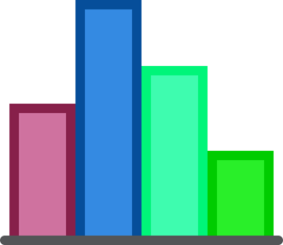
Data vs. Information
We seem to have a problem with Service. Let’s get some training for our staff.
@___restaurant TERRIBLE SERVICE, GREAT FOOD, worth the wait
@___restaurant terrible service, great food, worth the wait
Sentiment Analysis uses analytics to identify relevant tidbits
Tweets are a source of data
The outcome of such analyses is actionable information
Notes:
This is the path of data into the enterprise from random bits to actionable information from which conclusions can be drawn. In general, this is done by identifying the type of data you want to collect and perhaps the sources from which the data should come. Then, programmatically, the sources are polled for their data and the software brings the data into the enterprise. For example, the day’s exchange rates for all currencies might be pulled from a web service at your favorite bank.
When the data is gathered, it must be stored and managed. There are many ways to do this, the most common in the enterprise being the relational database (Oracle, MS Sql Server, MySql). At this point, database professionals work with the analysts to clean the data to make it usable…. but more on all this later.
Consider Twitter and its effect on customer service…
Twitter is often where people will go to express their opinion of a company’s customer service. The person’s tweet is issued from the Twitter software service and captured by any client software listening for it. How do we gauge the customer’s opinion? The tweet is natural language with all possibilities of interpretation as one would expect. Moving from natural language to quantifiable aspects of the mood those tweets are trying to convey is known as Sentiment Analysis and involves complex algorithms to determine the mood the tweets are trying to convey. Once the mood is read and quantified, analysis can begin and actionable information developed.
Now in the real world, we cannot develop a model of customer service progress from one person’s tweet(s). We need to identify all customers who are on Twitter talking about the company. When we get enough, the sentiment analysis of that scope of data can turn into real information.

Slide 6

Data And Information
CLASSROOM WORK
20 minutes
Use “sentiment.xlsx”
Column B-E: Add terrible, good, awful, bad
Add this formula
=IF(ISNUMBER(SEARCH(B$1,$A2)), 1,0)
Create pivot table, charts

Slide 7
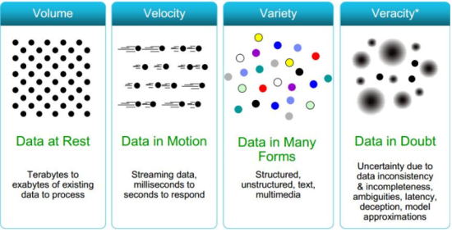
The Many “Vs” of Data
Notes:
The process of bringing data into the enterprise requires the consideration of the Vs of data
Volume – what is required, what is available, and what can be stored internally all force one to think about the amount of data (Mega, Tera, Peta) being considered for a given project
Velocity – issues of availability of data due to the physical limitations of moving the data through the networks have to be considered when planning an analysis project
Variety – bringing data from the many different external sources (tweets, Yelp, Facebook, Government centers, etc) to be used internally requires transformation from many different forms
Veracity – when using external data, what is the quality of that data? Is it good enough to lead to actionable information with a high degree of confidence?

Slide 8
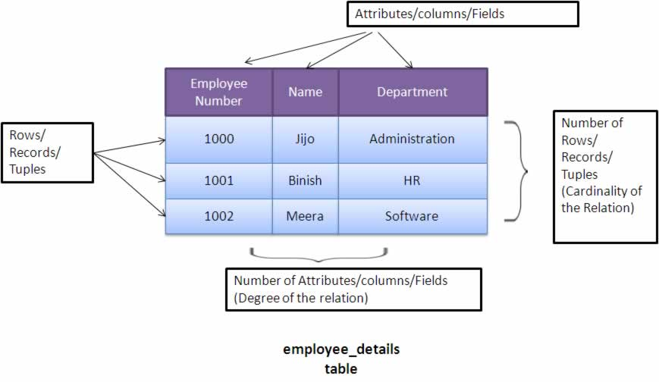
Structured Data
Image: Careerbless
Notes:
The internal enterprise usually makes use of highly structured data. Relational databases are the norm inside of most major organizations. These implement rules around highly structured collections of information enforcing:
Data types
Relationships between tables
Constraints on what data can be entered (beyond just data type)
When data is managed by a RDBMS, a lot of the dirtier aspects of data are automatically handled. This is because the data types and relationships will “kick out” anything that violates these when the data comes into the enterprise. Of course, this can also mean that some valuable data is lost. Why is it valuable if it is dirty? Depends on the situation. For example, some survey responses may be rejected because the respondent did not enter their city in the form. It all depends on what you decide is necessary when you frame the problem. We will see this many times throughout this course. In the end, the analyst is indispensable. The automated processes and analytical tools are not foolproof means to an end.

Slide 9
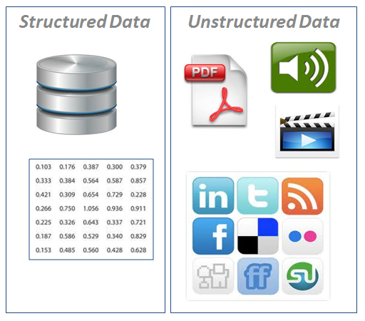
Unstructured Data
…everything else.
Image: Infosys
Notes:
Even though different applications like PDF and MPEG have a structure, the data placed in them can be unstructured. Consider the title of a document in a PDF. PDF rules may be enforced to center and bold the title, but the words in the title itself may be anything from simple text to text with numbers and symbols, of a variety of lengths and case. This way, PDF readers know how to typeset the document, but the data they are typesetting is not in any structure in the RDBMS sense.

Slide 10
Types of Data
Internal/External
Internal data most relevant to tactical
Great external sources exist, but often at a cost
Notes:
Internal data is data that is within the enterprise. The data is created by the enterprise, stored and managed by the enterprise. It spends its entire lifetime under your control. External data comes from somewhere else. It is gathered by you (or someone with your team) but its initial integrity is under the control of an outside group. Generally, if you want high quality data, that data comes with a fee. However, it may be that the fee is reasonable compared what it would take for the internal team to develop it.
Consider demographic data for an advertisement you want to run. There are companies that specialize in maintaining demographic databases that you can purchase. They may be expensive, but to reproduce this data on your own requires a considerable effort and expense.

Slide 11
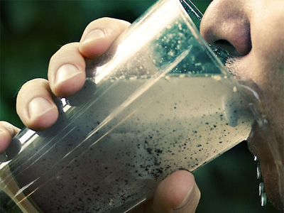
Data Quality should be a priority
Notes:
In the end, bad data is worthless and potentially very damaging to the organization. The damage can be in many forms, but, ruling out actual malicious code, the damage is in the form of erroneous conclusions for the enterprise. A great deal of money can be lost if conclusions are faulty and the first place to start to prevent that is to ensure that the data is clean. What does it mean to be clean? We will cover these in the next slides.

Slide 12
Data Quality
CLASSROOM WORK
30 minutes
Use “survey.xlsx”
Apply filter and check if you find same id with different names
For column G
(a) Average of rows from 15 to 900
(b) (Sum of rows from 15 to 900)/(900-15)
note the difference between a and b. Why ?

Slide 13
Starting on the right foot
Cleansing means:
Removing duplicates
Having a single source of truth (SSOT) for core records
Standardizing core fields Identifying sparsely populated fields
Unique IDs
Notes:
One aspect of dirty data is data duplication. Perhaps you are tracking a group of people for a medical study over a period of one year. Imagine if you do not account for spellings of a person’s name when you take the second or third survey – Jane Doe submits the second survey as J. Doe and becomes two different people in the database. Now the data is not tracking Jane’s first and second surveys, but you are tracking two different people. One simple way to prevent this is the Single Source of Truth where every participant is tracked by a unique ID and the name is keyed into the DB once and only once. This prevents multiple copies of a name in multiple places in the data that are seemingly different but actually the same.

Slide 14
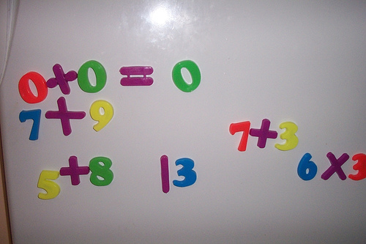
Starting on the right foot
The risks of skipping or neglecting data cleansing:
Inaccurate analysis
Wasted time/money
Inconsistent results
Notes:
There are many ways that dirty data leads to these results. Some more ways,
Duplicate records can lead to improper sample sizes when performing simple statistics
Data sources which provide continuous data updates (say from stock information) can generate inconsistent trending information when the data is not treated properly on import.

Slide 15
Common Issues/Causes
Key Issues
Duplicates
Missepllings
Inconsistent formatting
Inconsistent data population
Missing/duplicated unique keys
Special characters
Why they happen
Manual Entry
Old Business Rules Applied
Software version changes
Poor future planning
Botched administrative efforts
Poor interface/process design
Notes:
These are a list of some common causes of dirty data. Many of these are caused simply by working with manual entry. For instance, hand typing a department in a text field instead of offering a dropdown list of available departments the way most state dropdowns are available. The Y2K problem was an example of poor future planning as only two digit years were required for a very long time.
To look at just a few…
Inconsistent formatting is often found in dates.
Misspellings in names of people and places (from registration forms or surveys)
Inconsistent data population is often found when downloading an Excel file from an external data source. This is because data was not rigorously collected.
INSTRUCTOR NOTE
Ask the students when they encounter dirty data. What are the their issues with data quality and how do they work around them (resolve) ?

Slide 16
Data Quality
GROUP WORK
20 minutes
When do you encounter dirty data
What are the your issues with data quality
How do you work around them (resolve)

Slide 17
How to fix some of these issues
SSOT Services
Example: Buy cloud time on Azure to compare and sanitize your data records
Review policies and business rules that affect data capture
Implement projects to improve your data quality
Implement unique identifiers
Build a policy for quality “threshold” and error tolerance
Notes:
We already spoke about SSOT. This is very important. Consider the state dropdown mentioned a few slides ago. The SSOT for this is usually a database table with all of the state codes in it. Perhaps each one has an integer ID in the table as well. When there is any record stored for a user filling out this form (whatever form it may be), the state code is referenced by the ID in the table. The presentation on the screen comes from the SSOT table so that the spelling is always the same. When you need to generate a report, or view the state data for a given person in any way, you resolve the keys linking to the SSOT table, so that you always get consistent spelling.
If you have older projects, you can implement projects to review the older data and determine how it may be fixed. Even with new projects, review policies are important. Having a policy to kick data out when you need to preserve data integrity is usually referring to the minimum ”atomic unit” of data. The analytics team has to decide the minimum effective amount of data in any record. If the data integrity dips below the minimum, then it should just be rejected and noted in order to maintain quality of any conclusions drawn from the data.

Slide 18
Data Analysis Defined
We define some essential terms
Section 2

Slide 19
Data Analysis Defined
Data analysis: researching, organizing, and changing data in order to draw out useful information.
Notes:
Data is everywhere, but of itself is not useful. Information comes from analyzing data, but what does it mean to analyze data. There are, of course, specific analyses that everyone is familiar with – averaging the semester grades, percentage of people who shopped at Wal-Mart in the last 10 days, etc. To analyze data is to perform research in a field, organize data that is relevant in that field, and shape it in ways that tell us useful things. Changing data here does not mean that we change the data in any way we like to draw our conclusions, it means to refactor or reshape the data so that different dimensions are compared together, or to rescale so that two different variables are measured on the same graduation…things like that.

Slide 20
Why do we analyze data?
Decision Support
Trying to figure out what is going on
Ferret out the context or story
So we can intervene, fix or improve something
Looking for causes
Prediction
Using available data to project into the future
Monitoring and reporting
SWOT (strengths, weaknesses, opportunities and threats)
Notes:
We analyze data because we are looking for some useful information. The information can be to make a prediction, or to see where we have been and understand what happened in the past. Of course, the past is the past, but analysis of data about a past event can help us determine what is to come. Economics is a good example of analyzing past data. A recession is generally defined as two consecutive quarters of negative GDP growth. Basically, by definition, you cannot tell if the economy is in a recession until past data has been analyzed.
In order to make a prediction, we generally have to have a model. In order to make a model, we gather data and analyze it. Later in the course, we will work with moving data by analysis to a model. From the model, you can push outward and try to make predictions about the future. The accuracy of the predictions depends on many things, no the least of which is the quality of the data and analysis.
Data can also be use for monitoring and reporting problems. Why does it take data to determine if something is a problem ? A simple error in a computer network can just be reported as is when it occurs, but what about reporting credit card fraud? Credit card fraud, or at least potential credit card fraud, is found from mining millions of records and developing a model for what may be considered fraud. Then all new transactions are monitored and compared against data for what is considered normal. If the new transaction fails the “normal” test, then the monitoring system can notify the company about the potential fraud.
And then there is SWOT – strengths, weaknesses, opportunities and threats. You can read more about SWOT at Wikipedia (https://en.wikipedia.org/wiki/SWOT_analysis) but basically it is the structured approach to business planning. You can answer questions like “who may be moving into our market?” and “what markets may we be missing with our product?” by data analysis.

Slide 21
Data Analysis Mindset
Flexibility
Imagination
Persistence
Problem solving
Diligence
Patience
Notes:
The mindset of an analyst is one of curiosity and tenacity. Finding the story embedded in numerical data requires a lot of thought and persistence. One must also be comfortable with the lack of clear results. Very often the results of analysis are suggestive, but not definitive. Simply put, there is not an answer, only solutions which are better or worse than other solutions.

Slide 22
Hone Skills
It’s the user not (just) the tool
Hone deductive and inductive reasoning skills
Will have to know some programming languages
Interpretation skills are key
Do you know what you are seeing?
How will you minimize bias
Who will you collaborate with to ensure accuracy?
How will you share your findings?
Notes:
In the end, computers calculate. This is all that they do. It takes a person to discern the quality of the result. That quality relies on the proper framing of the problem, the best data sources, the proper analytical techniques for the field, and good communication of the results.

Slide 23
Data Analysis Steps
Define your objectives first
Determine the levers (metrics are key)
Collect the data (ensure an adequate sample)
Clean the data
Model the data (test, test, test)
Identify repeatable processes
Notes:
This set of steps is a guideline for the data analyst. Define your problem and what you want to accomplish, determine what metrics to measure and what constitutes success or failure (when applicable), gather the data and cleanse it, analyze and build your model and go over the cycle again.
When building a model, remember to test, test, test. Use the original data and make sure you get out of your model the actual result that the data suggests. Find other data and test against it. Make a short term prediction and test against the actual result. The process is a cycle because each new piece of relevant data improves the model.

Slide 24
Data Analysis Defined
Data Analysis
Considered a subcomponent of analytics
Often the goal of analysis is more exploratory than required for decision making
Analytics
The systematic computational analysis of data
Describes the data analysis that clusters, segments, scores, and predicts what is likely to happen next
The outcome should be an implementable decision based on the data
Notes:
The difference between analysis and analytics is one of degree. Analysis is usually reserved for using mathematics to look at data and turn it into information. Analytics often refers to a prebuilt or purchased package of analysis techniques commonly applied to a particular business or science problem.
For example, finding averages and percentiles is analysis. An analytics package will run the average and percentiles automatically. It obviously is not that simple, but that is the idea. Analytics is packaging a set of analysis techniques which we know to be relevant to a particular field.

Slide 25
Common Terms
Population: the pool from which the statistical sample is pulled
Sample: the set of collected data gathered from a statistical population
Average: the number that measures central tendency of a given set of numbers
Correlation: describes the strength and direction of a relationship between variables
Distribution: description of the relative number of times an outcome will occur in a number of trials
Observation: an element of a population or data set
Notes:
These are some common terms in analysis. Notice that a sample is a subset of a population, but the sample can be the entire population. This is a distinction which leads to two formulas for something called the standard deviation which will be seen later.
The average is never just the average. There are at least three commonly used averages which we will cover in this class. The average measures the central tendency of a set, which means that it describes where the numbers tend to be. It stands to reason that three averages probably measure slightly different things about that tendency. There will be more discussion in coming slides.
The distribution is an important concept and critical in developing models. It describes how outcomes are distributed. Of course, this uses almost the exact word it is meant to define so lets dig a little deeper. When you have outcomes of an event – coin tosses, games, catastrophic economic collapse on a global scale – the outcomes can be noted and, when performing the same test over and over again, the number of each outcome can be counted. When the outcomes are all noted and counted, they for a distribution.

Slide 26
Two domains of data analysis
Descriptive Statistics
When you have all of something
Inferential Statistics
When you have a representative sample of a population
You use the characteristics of the sample to make probabilistic estimates of the parameters of a population
Formal “Hypothesis Testing”
There is some overlap in analytical techniques in these two domains

Slide 27
Our focus here is Descriptive Statistics.
Data with characteristics analyzed with these tools are more common in business applications
The word “hypothesis” is used in this class not as formal “Hypothesis Testing” as found in Inferential Statistics but as a part of exploratory data analysis.
Hypotheses are often formed and abandoned as one approaches a better understanding of the data and the reality that generated them.

Slide 28
Descriptive Statistics
For example, if given a set of annual starting salaries:
Mean/Median/Mode of salaries
Salary averages
Variation in salaries
Descriptive statistics emphasizes measures of central tendency.
Notes:
Here is that phrase, central tendency, again. When we have a set of numbers, in this case starting salaries as reported by various companies, the central tendency describes how those number cluster together. That is the point of descriptive statistics – describing how things fit together.

Slide 29
Inferential Statistics
Inferential statistics allows for generalizations about the population using samples.
Limitations:
Providing data about population that may not be fully measured
Some tests require educated guesses based on theory to run tests
Methods are focused on parameters and testing statistical hypotheses.
Notes:
This is much more complex than simple descriptive statistics. The bulk of this course will ignore it, but it is important to be aware of the distinction. Inferential statistics has a broad array of tools and techniques used to come to conclusions about small samples of much larger populations. This is realm of medical studies for pharmaceuticals etc.

Slide 30
Types of Variables
We look at what kinds of variables are involved in data analysis
Section 3

Slide 31
Definitions: Variables
Variable
Numerical
Categorical
Interval
Ratio
Nominal
Ordinal
Notes:
Variables are classified according to the diagram on this slide. The classifications dictate how we can (and should) display data for these variables.

Slide 32
Definitions: Variables
Variable
Numerical
Categorical
Interval
Ratio
Nominal
Ordinal
Categorical: categorizes or describes an aspect of a population (E.g. blue, green, yellow)
Numerical: quantifies an element of a population (E.g. 1, 2, 3)
Notes:
Variables are classified according to the diagram on this slide. The classifications dictate how we can (and should) display data for these variables.

Slide 33
Definitions: Variables
Variable
Numerical
Categorical
Interval
Ratio
Nominal
Ordinal
Nominal: Categorical values that doesn’t have ordering. E.g. Blue, Green, Yellow
Ordinal: categorical values that has ordering. E.g. low, medium, high
Notes:
Variables are classified according to the diagram on this slide. The classifications dictate how we can (and should) display data for these variables.

Slide 34
Definitions: Variables
Variable
Numerical
Categorical
Interval
Ratio
Nominal
Ordinal
Interval: the distance between two values is meaningful (0 to 100 Celsius on a thermometer)
Ratio: possesses a unique, meaningful and non-arbitrary zero value (Kelvin on the thermometer)
Notes:
Variables are classified according to the diagram on this slide. The classifications dictate how we can (and should) display data for these variables.

Slide 35
Definitions: Variables
Variable
Numerical
Categorical
Interval
Ratio
Nominal
Ordinal
Notes:
Let’s go through these in some details with examples – starting with Nominal…

Slide 36
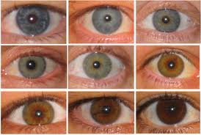

Nominal Variables
Nominal= “Name ONLY”
Nominal variables contain mere codes assigned to objects as labels, they are not measurements.
Not a measure of quantity. Measures identity and difference. People either belong to a group or they do not.
Notes:
Eye color: blue, brown, green, etc.; Biological sex (male or female)

Slide 37


Nominal Variables: More Examples
Marital Status: Married, Single, Divorced, Widowed
Country of Origin:
1 = United States
2 = Canada
3 = Mexico
4 = Other
(Notice: Numbers are only labels!!!)
Notes:
All of these are categories. Yes, the second one of these has numbers, but they are really just short hand for the labels. They are not really ordered numbers.
Notice that there is nothing here that is ranked in order of importance or quality or anything else. They are just labels.

Slide 38
Nominal Variable: What Statistics/Operations Can I Compute?
Statistics/Operation | OK to Compute?
Frequency Distribution and mode | Yes
Median And Percentiles. | No
Addition Or Subtraction. | No
Mean, Standard Deviation, Standard Error of The Mean. | No
Ratio, Or Coefficient Of Variation. | No
Notes:
This slide describes what calculations we can perform on nominal variables. Notice that it is not much. We can only describe the frequency distribution. If you do not already know what that is, don’t worry, we will cover it later. For now, just notice that nominal variables are limited in what they can be used for.

Slide 39
Definitions: Variables
Variable
Numerical
Categorical
Interval
Ratio
Nominal
Ordinal

Slide 40
Ordinal Variables: Order Matters
Ranks Individual attributes in same group
Unit of measure not available
Designates an ordering: greater than, less than.
Does not assume that the intervals between numbers are equal.
Example: student A is taller than student B
Notes:
As discussed, order matters here. Consider data that is collected from Jan 2016 through May 2017 every month. When displaying in a chart, January 2016 comes before January 2017, so any outcomes in 1/2016 should be displayed before 1/2017. We should not necessarily group all January data together regardless of year. Notice that January is still just a label. The labels do have a time ordering to them which ranks the outcomes in the labels.

Slide 41


Ordinal Variable: Examples
Rank your food preference where
1 = favorite food and 4 = least favorite:
____ sushi
____ chocolate
____ hamburger
____ papaya
Final position of horses in a thoroughbred race is an ordinal variable. The horses finish first, second, third, fourth, and so on.
Notes:
Also notice that the difference between first and second is not necessarily equivalent to the difference between second and third, or between third and fourth. You may love hamburgers slightly more than chocolate, but both way more than sushi and papaya.

Slide 42
Ordinal Variable: What Statistics/Operations Can I Compute?
Statistic/Operation | Compute?
Frequency Distribution. | Yes
Median And Percentiles. | Yes
Add Or Subtract. | No
Mean, Standard Deviation, Standard Error Of The Mean. | No
Ratio, Or Coefficient Of Variation. | No
Notes:
What can we compute? Well, since we have not covered the techniques yet, just notice that we have added one more group from our list by rank ordering the set.

Slide 43
Definitions: Variables
Variable
Numerical
Categorical
Interval
Ratio
Nominal
Ordinal

Slide 44
Interval Variables
Classifies data into groups or categories
Determines the preferences between items
Zero point on the internal scale is arbitrary zero, it is not the true zero point
Designates an equal-interval ordering.
Notes:
Now we are in the variables that work with numbers. You can imagine that this will open a new set of calculations we can perform on our set. These are some general statements about interval variables. Note that with numbers, we can define explicit intervals and make them equal in size (1-10, 11-20, 21-30, etc)

Slide 45
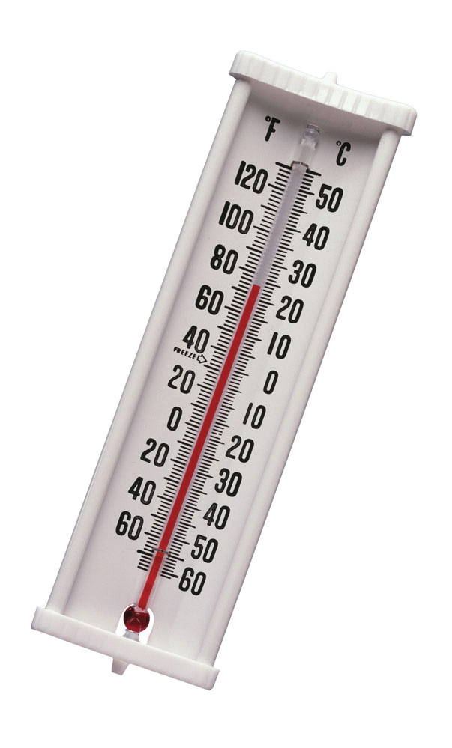
Examples
Interval Variables: Examples
Some Temperature Scales
Fahrenheit (25 is 5 degrees hotter than 20)
Notes:
It is meaningful to say that 25 degrees Celsius is 3 degrees hotter than 22 degrees Celsius, and that 17 degrees Celsius is the same amount hotter (3 degrees) than 14 degrees Celsius. Notice, however, that 0 degrees Celsius does not have a natural meaning. That is, 0 degrees Celsius does not mean the absence of heat!

Slide 46
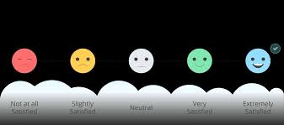
Interval Variables: Examples
How do you feel about “Intro to Data Analysis”?
1 = I’m totally dreading this class!
2 = I’d rather not take this class.
3 = I feel neutral about this class.
4 = I’m interested in this class.
5 = I’m SO excited to take this class!
Notes:
A Likert scale is common in surveys. This is an example of a survey question with a numerical values mapped to statements. They are often balanced around the middle point. Here you see 3 is the midpoint and there are two options higher and two options lower.

Slide 47
Interval Variables: Which Statistic/ Operation Can I Compute?
Statistic/Operation | Compute?
Frequency Distribution. | Yes
Median And Percentiles. | Yes
Add Or Subtract. | Yes
Mean, Standard Deviation, Correlation, Regression, Analysis Of Variance | Yes
Ratio, Or Coefficient Of Variation. | No
Notes:
Now we have greatly expanded what we can do for analysis. Numbers give us a lot of power.

Slide 48
Definitions: Variables
Variable
Numerical
Categorical
Interval
Ratio
Nominal
Ordinal
Notes:
Lastly…

Slide 49
Ratio Variables
This is the highest level of measurement and has the properties of an interval scale; coupled with fixed origin or zero point.
It clearly defines the magnitude or value of difference between two individual items or intervals in same group.

Slide 50
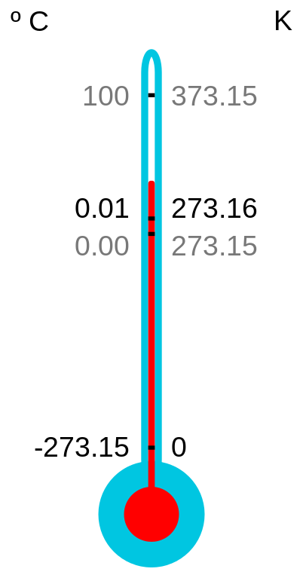
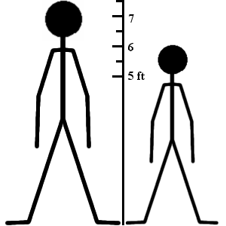

Ratio Variables
Temperature in Kelvin (zero is the absence of heat. Can’t get colder). 0 kelvin is -273 degree celsius
Measurements of heights of students in this class (zero means complete lack of height).
True Multiples: Someone 6 ft tall is twice as tall as someone 3 feet tall.
Heart beats per minute has a very natural zero point. Zero means no heart beats.
Notes:
We already saw Kelvin, now we add height (no one is negative inches tall), and heart beats (no one has negative heart beat).

Slide 51
Ratio Variable: What Statistics/Operations Can I Compute?
Statistic/Operation | Compute?
Frequency Distribution. | Yes
Median And Percentiles. | Yes
Add Or Subtract. | Yes
Mean, Standard Deviation, Correlation, Regression, Analysis Of Variance | Yes
Ratio, Or Coefficient Of Variation. | Yes
Notes:
And with ratio variables, we now have the spectrum.

Slide 52
Summary of Variable Types
Level of measurement:
(Variables)
Put data in categories
Arrange data in order
Subtract data values
Determine if one data value is a multiple of another
Nominal
Yes
No
No
No
Ordinal
Yes
Yes
No
No
Interval
Yes
Yes
Yes
No
Ratio
Yes
Yes
Yes
Yes
Notes:
The summary of everything covered to this section about the utility of variable types.

Slide 53
Central Tendency of Data
We look at the basic description of the typical values of data sets
Section 4

Slide 54
Central Tendency (Averages)
Characterizes a set of data by a central or typical number
Mean, Median, and Mode are most common measures of central tendency
Each of them has strengths and weaknesses
Notes:
When confronted with most sets of data, we want to know how it tends to cluster together. Where are the most points? Now we are speaking of this independent what the data actually measures, so it is an abstract concept, which is what makes it powerful. By powerful, we mean that applying the same math to vastly different sets allows you to draw conclusions about those sets. Remember, for the information to be useful, you have to know something about the field the sets are from. Knowing the average of the number of particles emitted from a radioactive isotope and the average of the population of North American cities doesn’t really lead you to any conclusions without knowing the problem.

Slide 55
(Arithmetic) Mean
Most common meaning of “Average”
Sum of all individual elements divided by the total number of elements
Affected by sensitive to outliers
Be careful about weights and units
Notes:
This is what most people mean when they say average. The mathematical definition is next.

Slide 56
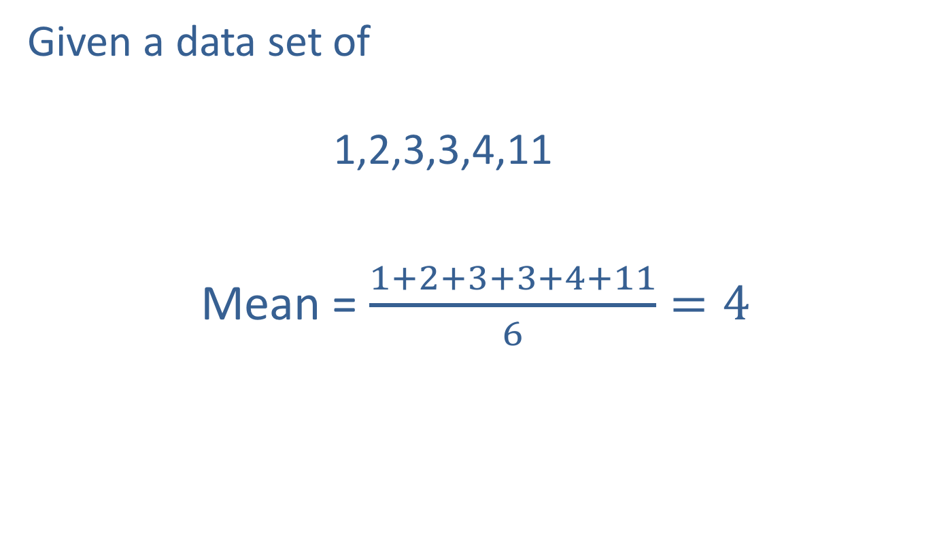
(Arithmetic) Mean
Given a data set of 1,2,3,3,4,11
Mean = $\frac{1+2+3+3+4+11}{6}=4$
Notes:
We just add the numbers in the set together and divide by the number of elements in the set. The result is a single number that we set clusters around. Note that the numerical result may not actually actually be in the set (the average of 2 and 3 is 2.5).
Notice what happens if I add another number, say 215, to the set. What happens to the average?

Slide 57
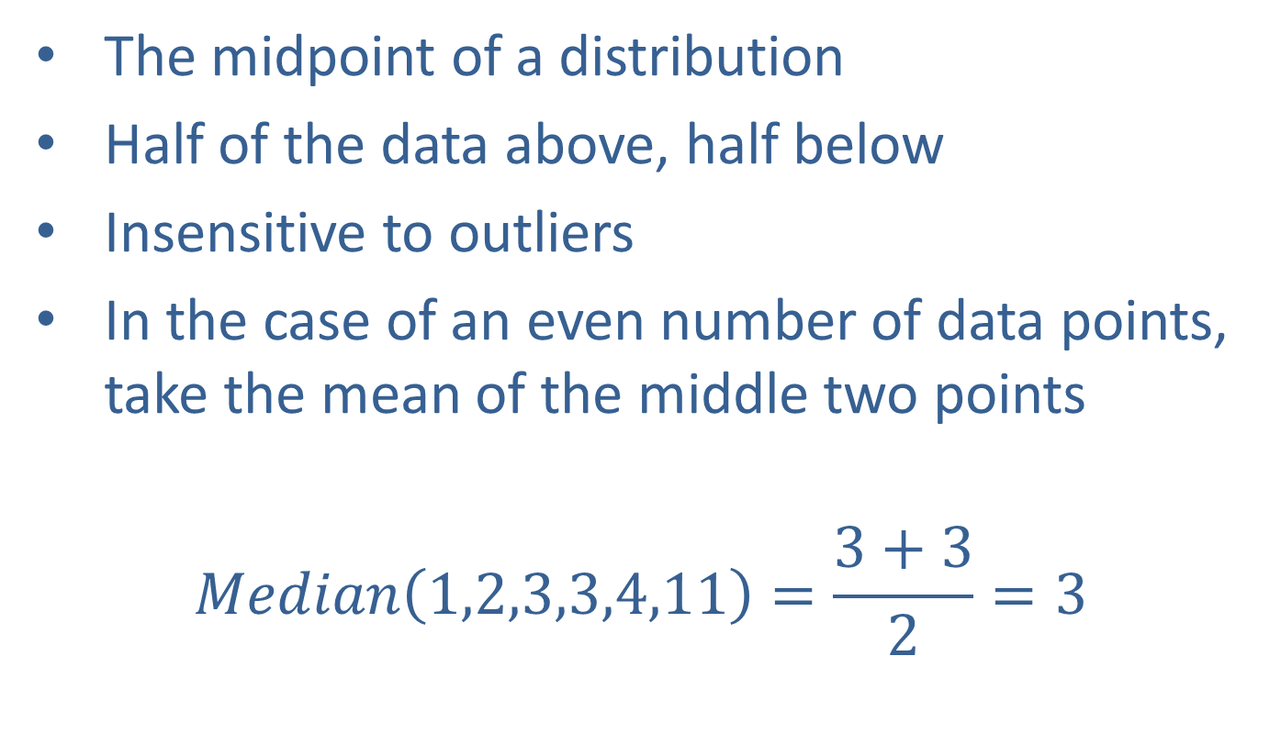
Median
The midpoint of a distribution
Half of the data above, half below
Insensitive to outliers
In the case of an even number of data points, take the mean of the middle two points
$$Median\left(1,2,3,3,4,11\right)=\frac{3+3}{2}=3$$
Notes:
This is another way of clustering around a single number in a set, but here, the number is in the set. This average is insensitive to outliers because adding another number that is really large or really small compared to the existing set doesn’t significantly change the actual count of the data by much, so the “half above and half below” value is not affected much.

Slide 58
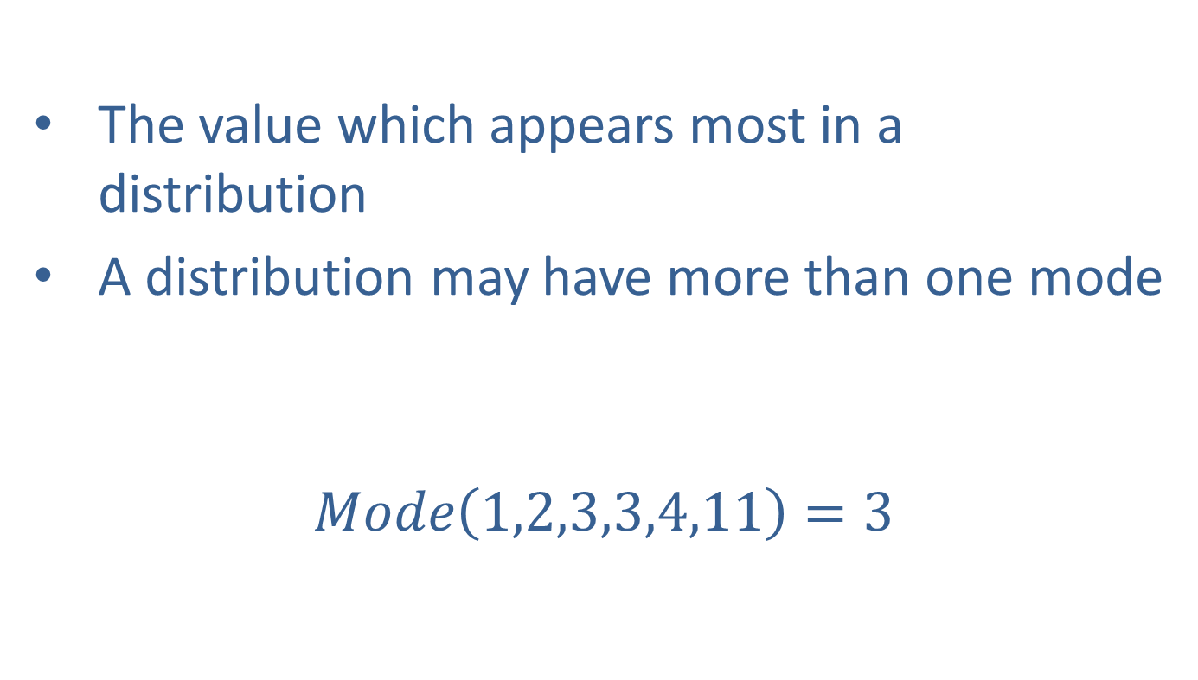
Mode
The value which appears most in a distribution
A distribution may have more than one mode
$$Mode\left(1,2,3,3,4,11\right)=3$$
Notes:
This clustering description also generates a number that is in the set. It is also insensitive to outliers because outliers don’t usually occur multiple times.

Slide 59
Central Tendency
CLASSROOM WORK
30 minutes
Exercise 2.1 Use “Gradebook Single.xlsx”
Grades for 44 students out of 20
Task:
Create a column for out of 100 grades
Find Average (=Average), Standard deviation (=STDEV.P), Min (=min), Max (=max)
Find frequency count and plot the graph (=Frequency)
Find cumulative frequency and plot the graph

Slide 60
Central Tendency
CLASSROOM WORK
30 minutes
Exercise 2.2 Use “Gradebook.xlsx”
Three tests - Grades out of 100
Task:
Find Average (=Average), Standard deviation (=STDEV.P), Min (=min), Max (=max) for all three tests
Find frequency count and plot the graph (=Frequency) for all three test together
Find frequency count and plot the graph (=Frequency) for individual tests

Slide 61
Central Tendency
GROUP WORK
20 minutes
Draw Conclusion and Give Recommendations

Slide 62
Day 1

Slide 63
Basic Probability
We look at the basics of gambling and how they apply to pretty much everything
Section 5

Slide 64
Probability
The measure of the likelihood that an event will occur.
Often Associated with gambling, but has applications in business, finance, manufacturing, science and other fields.
Expressed as a number between 0 and 1, where 0 means no chance of occurring and 1 means it will certainly occur.
Notes:
Probability is just a game of counting. It describes such things as
Heads vs Tails
Number of times you will draw an ace out of a deck
Likelihood you will roll a 7 on two dice
How likely are you to get a red 32 in roulette
Are you sensing a theme here? There is a reason. Gambling was a primary motivator behind the study of probability.
You often here things like a 10% chance of rain, but it is important to remember that probability is really measure between 0 and 1. We just tend to multiply by 100 when we present results to non-analysts.

Slide 65
Probability Uses In Business
Quality Control (Manufacturing Defects, etc.)
Six sigma Quality
Sample Design for Surveys (Random Samples)
Predictive Analytics (Decision Trees, Monte Carlo Simulations, etc.)
Risk Management
Stock Control (Predict when items need to be reordered)
Notes:
All of these are commonplace applications of probability (and statistics).

Slide 66
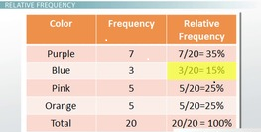
Probability: Several Ways We Can Calculate It
Simple probability calculated from frequencies

Slide 67
Probability: Several Ways We Can Calculate It
Conditional probability from tree diagrams
Simple probability:
P(rain) = 0.7
P(no rain) = 0.3
Sum = 1.0
Joint probability:
P(play) = 0.14+0.27 = 0.41
P(no play) = 0.56+0.03 = 0.59
Sum = 1.0
Conditional probability
P(play given rain) = 0.14
P(play given no rain) = 0.27
P(no play given rain) = 0.56
P(no play given no rain) = 0.03
Sum = 1.0
We play
0.2
0.7*0.2 = 0.14
Rain
Not play
0.8
0.7*0.8 = 0.56
P
0.7
0.3
We play
No Rain
0.9
0.3*0.9 = 0.27
0.1
Not play
0.3*0.1 = 0.03
P(rain given play) = p(rain|play) = ???

Slide 68
Probability Terms
Event: The outcome to which the probability is assigned.
“Heads” on a flipped coin.
4 on a rolled die
A Queen drawn from a deck of cards
Sample Space: The set of all possible outcomes
Heads and Tails
1, 2, 3, 4, 5, 6
The 52 cards
Independent: The outcome of one event does not effect a different event
Flipping two coins
Dependence: The outcome of one event effect a different event
(playing given rain) OR (playing given no rain)
Notes:
The event is the thing that we are performing (flipping a coin) and the outcome is the result of the event when measured (got heads). We assign the probability of getting the outcome of heads when we have the event of flipping a coin (in this case, it is P=0.5).
The sample space describes all of the possible outcomes that an event can have.
“Independent” will be an important term for us. The notion that one coin flip does not affect the outcome of another coin flip, or that a person’s height does not depend on another randomly selected person’s height, is very powerful and leads to insightful mathematics.

Slide 69
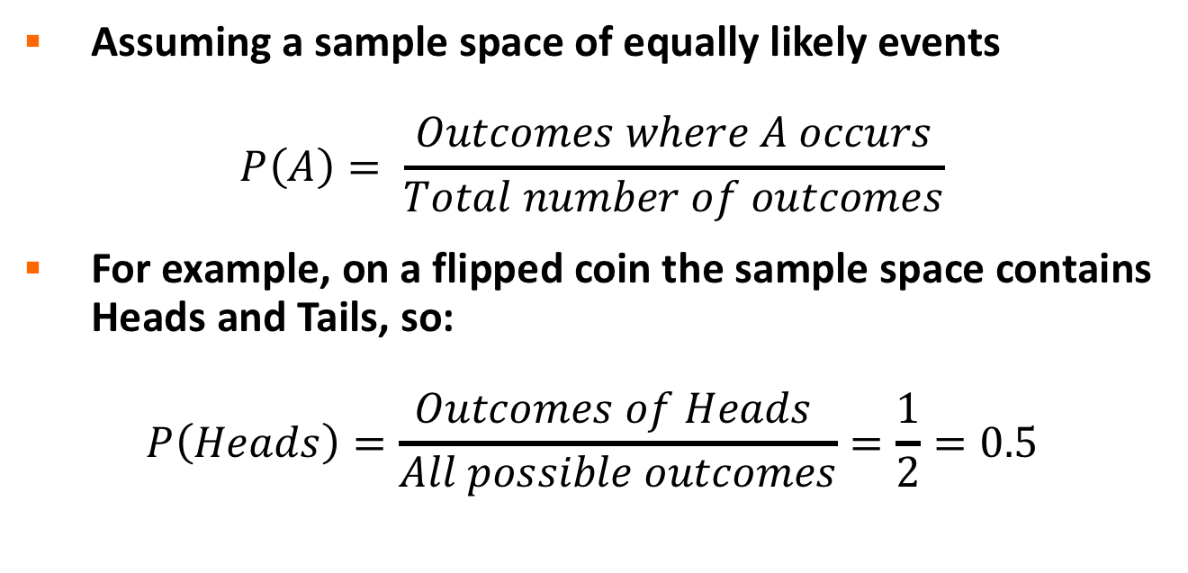
Calculating Probability
Assuming a sample space of equally likely events
$$P\left(A\right)= \frac{Outcomes where A occurs}{Total number of outcomes}$$
For example, on a flipped coin the sample space contains Heads and Tails, so:
$$P\left(Heads\right)=\frac{Outcomes of Heads }{All possible outcomes}=\frac{1}{2}=0.5$$
Notes:
The math described here speaks for itself, but it is one of the first mathematical descriptions, so spend some time understanding the notation. P(A) is the probability of an outcome that we label as A. The probability is calculated by dividing the number of ways that A occurs by the total number of possible outcomes.
When flipping a coin, heads can only occur one way and there are two possible outcomes for the coin toss. Therefore, P(H) = 1/2

Slide 70
Calculating probability
CLASSROOM WORK
30 minutes
If I flip 2 fair coins one by one:
what is the sample space
what is the probability I get at least one head?
If I roll two fair dices at once:
what is the sample space
what is the probability that the sum is 4?

Slide 71
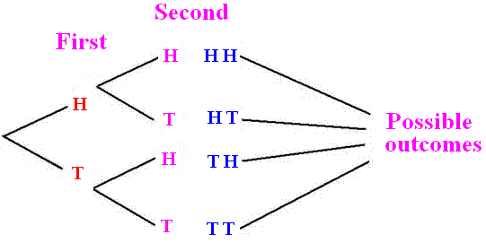
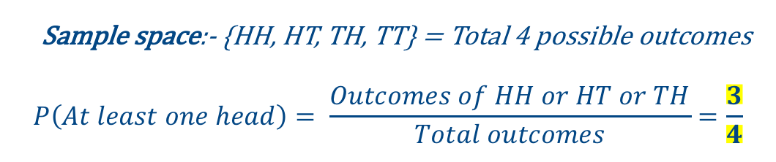
Calculating probability Answer 1
If I flip 2 fair coins one by one:
what is the sample space
what is the probability I get at least one head?
Sample space:- {HH, HT, TH, TT} = Total 4 possible outcomes
$$P\left(At least one head\right)= \frac{Outcomes of HH or HT or TH}{Total outcomes}=\frac{3}{4}$$

Slide 72
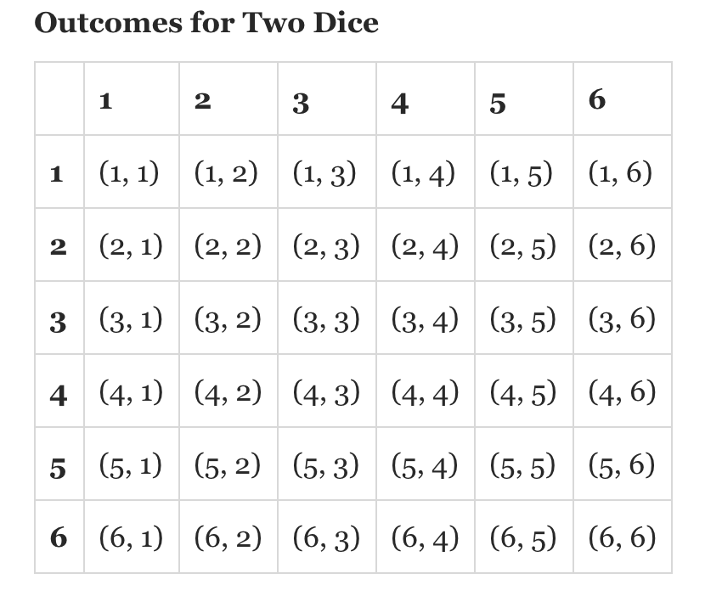
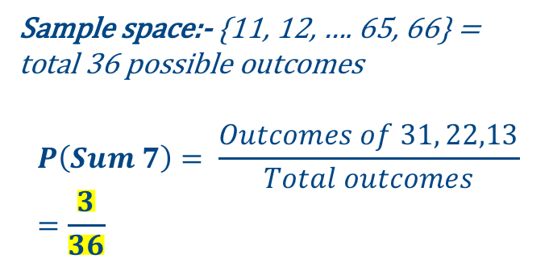
Calculating probability Answer 2
If I roll two fair dices at once:
what is the sample space
what is the probability that the sum is 4?
Sample space:- {11, 12, …. 65, 66} = total 36 possible outcomes
$$P\left(Sum 7\right)= \frac{Outcomes of 31, 22,13}{Total outcomes}=\frac{3}{36}$$

Slide 73
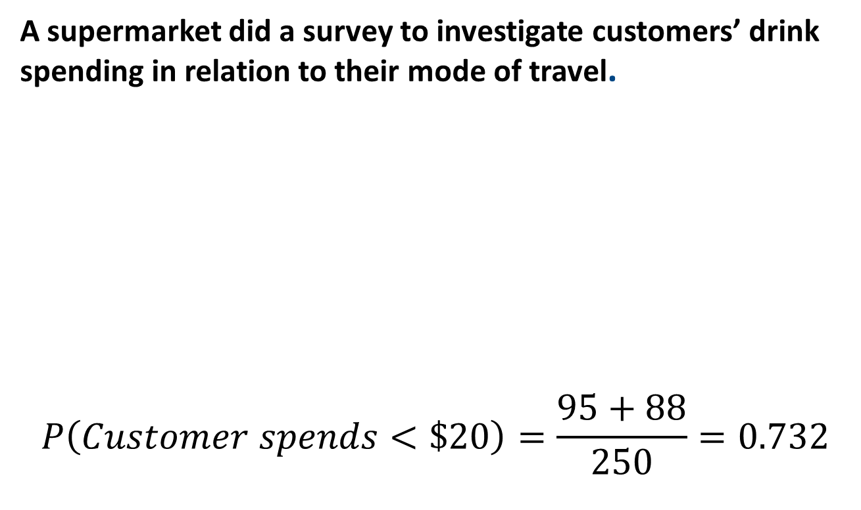
Calculating Probability from a Contingency Table
A supermarket did a survey to investigate customers’ drink spending in relation to their mode of travel.
$$P\left(Customer spends<\$20\right)=\frac{95+88}{250}=0.732$$
Notes:
The contingency table allows the analyst to read the count of the outcomes directly from wither the row or column. In this example, to determine the probability that a customer spends less $20 for refreshments is found by reading the last row (Total) for all columns where the money spent is less than $20. Adding up the counts in the two columns is the outcome count for this outcome. Then divide by the total count of outcomes in the last column.
Can you repeat this to answer the question “What is the likelihood that a person will spend less than $20 given that they took the bus to the store?”

Slide 74
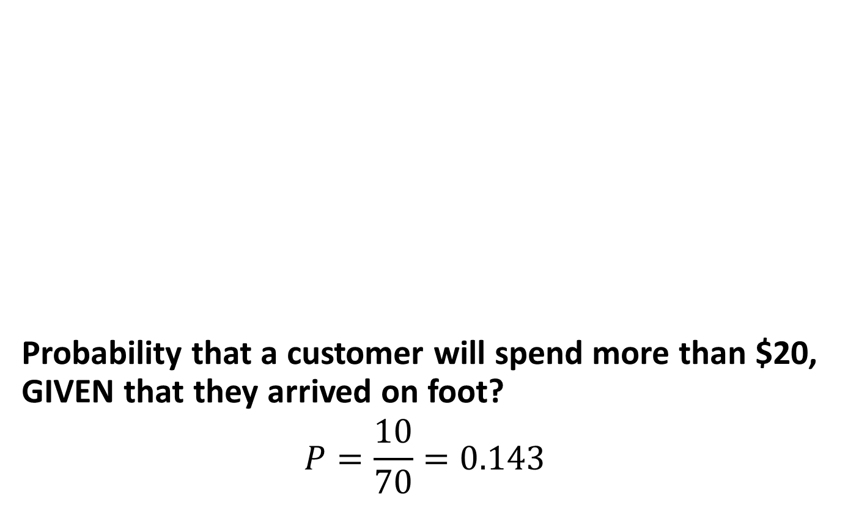
Conditional Probability
Probability that a customer will spend more than $20, GIVEN that they arrived on foot?
$$P=\frac{10}{70}=0.143$$
Notes:
A little more practice but this involves the challenge in the last slide. The part about the ”given that they took the bus”. Here, there are 70 people total who came on foot and 10 of those spent at least $20. This is the conditional part… the “given that”. Now try the challenge question from the previous slide.

Slide 75
Conditional Probability – Bayes Theorem
Same as the last slide but more formally

Slide 76
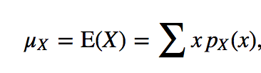
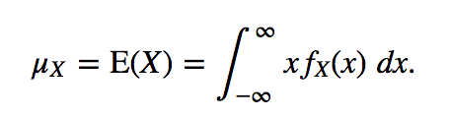
Expected Value
Expectation:-
mean or expectation - measure of 'central location' of a random variable
Discrete Random Variable
Continuous Random Variable
Notes:
The ”Expected Value” of this set of numbers is defined by the probability with which they occur. Given this set of numbers and the probability that each number occurs in the table, the value one would expect on any observation is defined by the sum of the products of x(n) and the P(n). In this set of observations, the expected value is calculated to be 120.

Slide 77
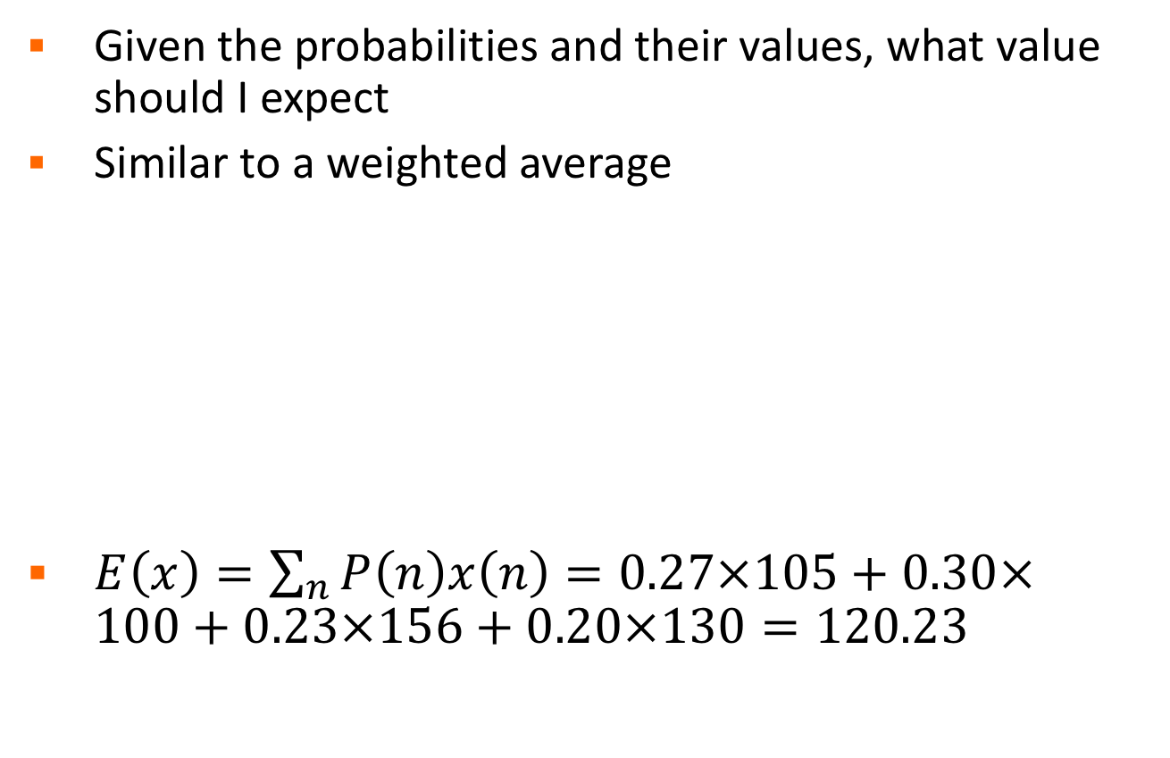
Expected Value
Given the probabilities and their values, what value should I expect
Similar to a weighted average
$E\left(x\right)=\sum_{n}{P\left(n\right)x\left(n\right)}=0.27×105+0.30×100+0.23×156+0.20×130=120.23$
Possibility (n) | Probability P(n) | Return x(n)
1 | 0.27 | 105
2 | 0.30 | 100
3 | 0.23 | 156
4 | 0.20 | 130
Notes:
The ”Expected Value” of this set of numbers is defined by the probability with which they occur. Given this set of numbers and the probability that each number occurs in the table, the value one would expect on any observation is defined by the sum of the products of x(n) and the P(n). In this set of observations, the expected value is calculated to be 120.

Slide 78
Frequency Distribution
The frequency with which observations are assigned to each category or point on a measurement scale.
Most basic form of descriptive statistics
May be expressed as a percentage of the total sample found in each category
Notes:
This the definition of the frequency distribution. It is the workhorse of descriptive statistics. First we define categories, then we observe something. We assign each observation to a category and then count how many are there. That’s all there is too it!

Slide 79
Frequency Distribution
How the distribution is read depends on the measurement level.
Nominal scales are read as discrete measurements at each level
Ordinal measures show tendencies, but categories should not be compared
Interval and ratio scales allow for comparison among categories
Notes:
Be careful about how you interpret though, the type of variable limits the analysis that can be done.

Slide 80
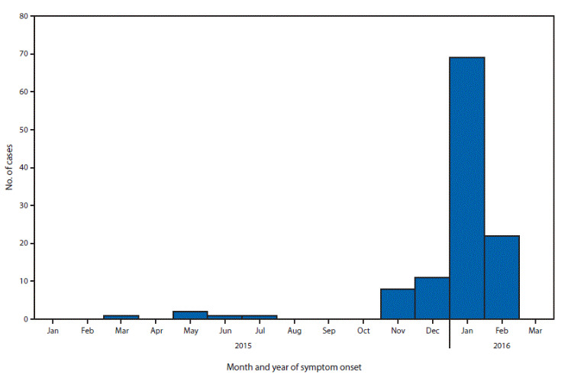
Frequency Distribution
Figure. Month of illness onset for 115 patients with laboratory evidence of Zika virus infection among residents of U.S. states and the District of Columbia — January 1, 2015–February 26, 2016*
Notes:
The distribution you see here has two important points to note:
The buckets (bins) are time ordered, or ordinal, values
The sum of all bins is 115 patients
Additionally, see how the x axis is laid out over two years. This is an example of where it is important that we do not combine both Januarys together because the time ordering tells us something important.

Slide 81
Probability – Frequency Distribution
CLASSROOM WORK
30 minutes
Start with Probability.xlsx
Plot frequency distribution plot for {2 heads, 1H 1T, 2 tails} outcomes from 2 flips of a coin
Plot frequency distribution plot for all possible outcomes of sum of 2 dice rolls

Slide 82
Distributions
We look at at how probabilities of events lead to distributions, how to describe these distributions, and what they tell us
Section 6

Slide 83
Distributions
Mathematical description of the probabilities of events
May be discrete or continuous
All probabilities should sum to 1
Notes:
When frequency plots categorize all of the population, they lead us to distributions. Distributions show how all of the population is distributed among the space of outcomes. The can be discrete, where the outcomes are small and countable, or continuous, like the real number line. When looking at a distribution, the frequencies of each outcome added together should add to 1.

Slide 84
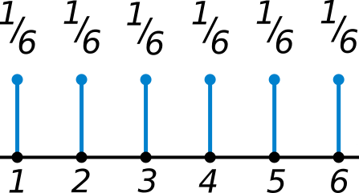
Discrete Distributions
Probability Mass Function (PMF) –
If X is a discrete random variable, and its range is a countable set, the possible outcomes can be = {x1, x2, x3, ….}. The probabilities of events {X = xi} are formally shown by the probability mass function
Thus it is used to calculate P(X = x) = some discrete value
Notes:
You can determine the probability that a discrete variable will be exactly equal to a particular value.
In this case, we are looking at a single six sided die. The probability of rolling any number on that die is shown in the PMF pictured. When we add all of the probabilities, we get 6*(1/6) to get 1.

Slide 85
Continuous Distributions
Probability Density Function (PDF) –
If X is a continuous random variable, and it’s range is not a countable set, the possible outcomes can be anything.
Since there are infinite number of possible values, the absolute likelihood of a random variable to take a value X is zero.
Thus P(X = x) = 0 for all x belongs to real number
Notes:
You can determine the probability that a discrete variable will be exactly equal to a particular value.
In this case, we are looking at a single six sided die. The probability of rolling any number on that die is shown in the PMF pictured. When we add all of the probabilities, we get 6*(1/6) to get 1.

Slide 86
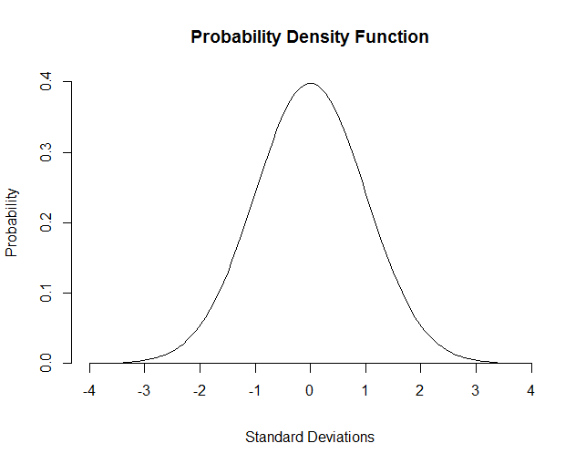
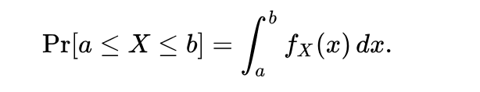
Continuous Distributions
How much more likely it is that the random variable would equal one sample compared to the other sample.
relative likelihood of a certain X value occurring
Sum over a range to get a probability.
This probability is given by the integral of this variable’s PDF over that range
Notes:
You can determine the probability that a continuous variable will be equal to a particular value by summing (integrating) over a range. In this case, we are looking at a what’s called a normal distribution.
We will not be integrating in this class, we will let the tools do it for us, but it is important to understand what it means. In this distribution, we must integrate from -4 to 4 to obtain 1. Notice that there are an infinite number of points between any two numbers on the scale.

Slide 87
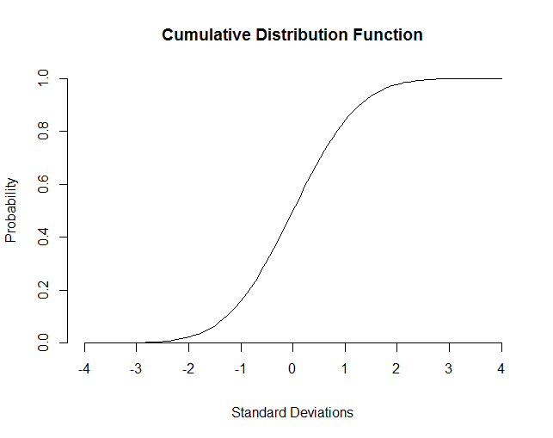
Continuous Distributions
Cumulative Distribution Function - probability of a particular X value or less occurring.
Notes:
The continuous distribution on the left is the probability density function that we saw in the last slide. The function on the right is what happens when we integrate the one on the left at each stage. It is cumulative, or it keeps adding, as we move from -4 to 4. When you use Excel functions to sample distribution functions, the cumulative function is often used.
INSTRUCTOR NOTE
From Wikipedia entry on probability density function
“In probability theory, a probability density function (PDF), or density of a continuous random variable, is a function, whose value at any given sample (or point) in the sample space (the set of possible values taken by the random variable) can be interpreted as providing a relative likelihood that the value of the random variable would equal that sample.^{[citation needed]} In other words, while the absolute likelihood for a continuous random variable to take on any particular value is 0 (since there are an infinite set of possible values to begin with), the value of the PDF at two different samples can be used to infer, in any particular draw of the random variable, how much more likely it is that the random variable would equal one sample compared to the other sample.”
Pay special attention to part where the relevant information is between two different samples, not exactly at the particular value
From Wikipedia entry on cumulative dist function
“In probability theory and statistics, the cumulative distribution function (CDF, also cumulative density function) of a real-valued random variable X, or just distribution function of X, evaluated at x, is the probability that X will take a value less than or equal to x.
In the case of a continuous distribution, it gives the area under the probability density function from minus infinity to x.”

Slide 88
Measure and Variability
There will always be variability in the data.
Statistics helps measure and characterize variability.
For example, controlling (or reducing) variability in a manufacturing process equates to statistical process control.
Notes:
We are building up the basic tools for analysis. So far, we have learned the basics of probability and how they lead to distributions (of which, we will cover a number of them later). Now we begin to describe those distributions.
Since distributions are the plots of outcomes, they are made from data. Real data always has variability because the world is a messy place. Statistics helps us characterize the variability. By doing this we can determine such things as quality in a manufacturing process, or the likelihood that some even will happen in the future.
What follows are some definitions of concepts that define the variability of data.

Slide 89
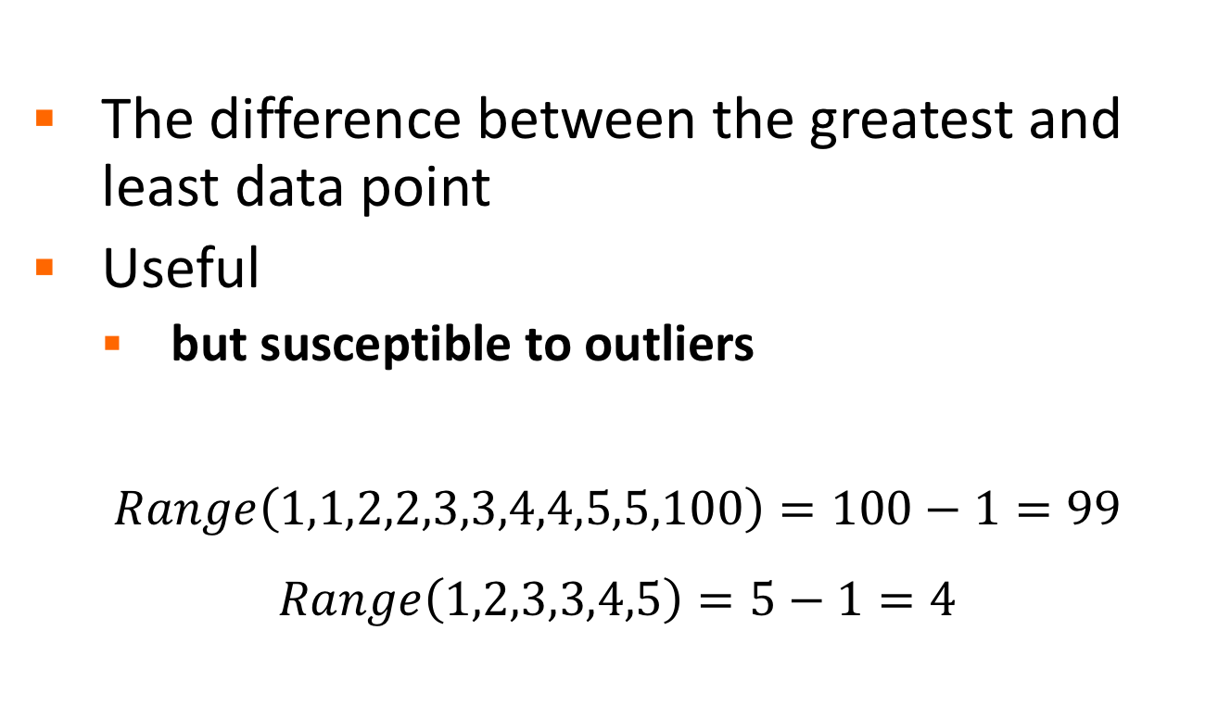
Variation by Range
The difference between the greatest and least data point
Useful
but susceptible to outliers
$$Range\left(1,1,2,2,3,3,4,4,5,5,100\right)=100−1=99$$
$$Range\left(1,2,3,3,4,5\right)=5−1=4$$
Notes:
The Range includes all outliers. The definition of an outlier will come later, but it is important to remember when characterizing a data set that the range, when reported, includes the entire set.

Slide 90
Variation by Quartiles
Divide distribution into 4 sets with equal numbers of points
25% of the data is less than the First (or Lower) Quartile
The Median is the Second Quartile
25% of the data is greater than the Third (or Upper) Quartile
The Interquartile Range is the difference between the Third and First Quartiles

Slide 91
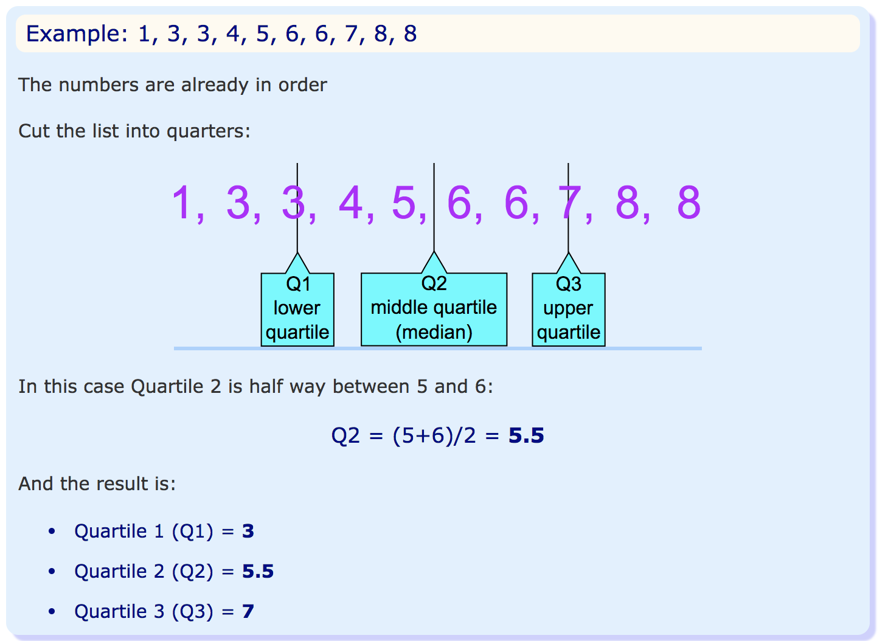
Quartiles

Slide 92
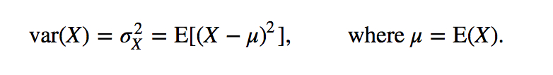
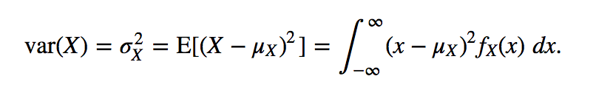
Variation by Variance
Squared differences between the mean and each observation, divided by N
It is always positive but not scaled to the observations
Say, miles squared versus miles
discrete
continuous
Notes:
The Variance, defined in this slide, is the Expectation Value of the squared deviation from the mean. Compare the definition above with the definition of the Expectation Value and note how the values of P(n) = 1/N for each observation in the data set. Then x(n) is the squared difference between the mean and the value of each observation.

Slide 93
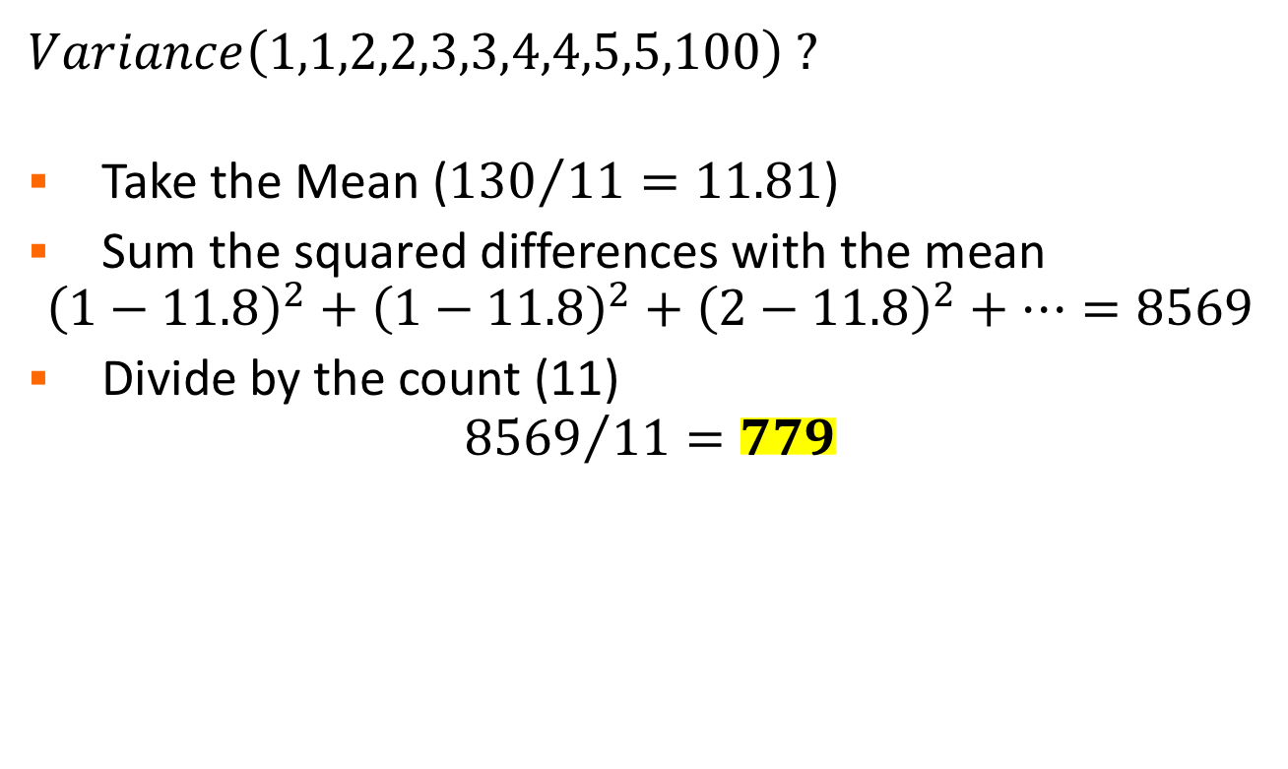
Variance
$Variance\left(1,1,2,2,3,3,4,4,5,5,100\right)$ ?
Take the Mean (${130}/{11}=11.81$)
Sum the squared differences with the mean
$${\left(1−11.8\right)}^{2}+{\left(1−11.8\right)}^{2}+{\left(2−11.8\right)}^{2}+…=8569$$
Divide by the count (11)
$${8569}/{11}=779$$

Slide 94
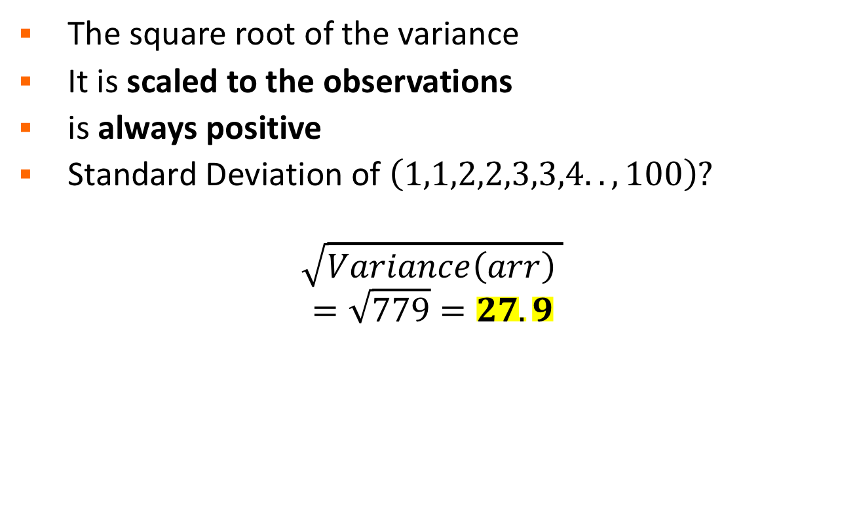
Standard Deviation
The square root of the variance
It is scaled to the observations
is always positive
Standard Deviation of $\left(1,1,2,2,3,3,4..,100\right)$?
$$\sqrt{Variance\left(arr\right) }$$
$$=\sqrt{779}=27.9$$
Compare 27.9 with 99, that was the Range
Which explains data variability better ?

Slide 95
Population vs. Sample
The definitions above are for the Population variance and standard deviation, i.e. when you have all of the data.
VAR.P() and STDEV.P() in excel.
If you only have a Sample of the data divide by N-1 instead of N for technical reasons.
VAR.S() and STDEV.S() in excel.
Notes:
Remember earlier in the course when we talked about population and sample? We consider analysis when we have knowledge of the full population for most of this course. Often, the real world considers samples of a population. This leads to a subtle difference functions for the standard deviation and the variance. The difference is in the use of Bessel’s Correction.
The explanation of the N-1 (Bessel’s Correction) is complex, but is related to the fact that you are estimating the mean of the population from the sample mean. This introduces bias into the calculation that is corrected by the N-1.

Slide 96
Application of the Standard Deviation
Measures deviation of any distribution
Low value indicates values are close together
High value indicates values are spread over wider range
But… when applied to the Normal Distribution, it means specific things
Notes:
We talked about the variance and the standard deviation. They apply everywhere, but when applied to a specific distribution, the std dev tells us many things. So let’s talk about the normal distribution.

Slide 97
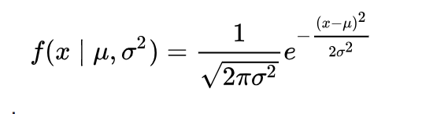
Normal Distribution
Also called Gaussian – the most common continuous probability distribution
Events are independent and heteroskedastic
Useful because of the Central Limit Theorem - under some conditions (mentioned above), it states that averages of samples of observations of random variables independently drawn from independent distributions converge in distribution to the normal
Notes:
Central Limit Theorem say, basically, that the outcome of a large number of measurements of independent random variables will be distributed along the normal curve seen here. The details are unimportant to the scope of the class, but because of this theorem, the normal distribution show up in a lot of places in nature, technology, business, etc. Most popular appearance is in the Bell Curve of IQ in the last couple of decades.

Slide 98
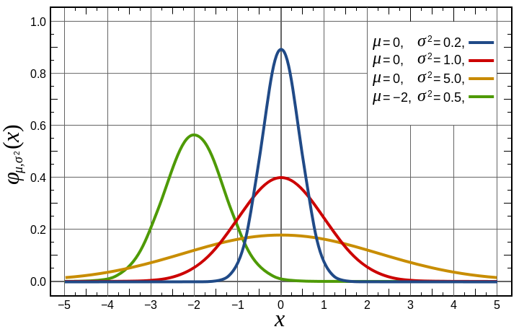
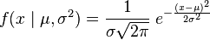
The Normal Distribution
Ideal normal distribution:-
Mean, median, mode overlaps – but this never happens in real world data
Notes:
Image is from Wikipedia https://en.wikipedia.org/wiki/Normal_distribution#Definition
This plot shows the normal curve and how it changes with the value of the mean (moves left or right) and the standard deviation (tall and thin, or short and fat).
The mathematical equation is not important for this class, but sometimes, people like to see what is happening behind the scenes. Notice that the funny little u character, called mu, is the arithmetic mean, and the o with loop on it, sigma, is the std dev. When we square the std dev, we get the variance. So this formula has the average, the std dev and the variance all in the same equation.

Slide 99

Standard Deviation and the Normal Distribution
For Normally Distributed Data
Sigma Percent
+/- 1 sigma 68.27%
+/- 2 sigma 95.45%
+/- 3 sigma 99.73%
+/- 6 sigma 99.9999998%
Six Sigma Quality
Image: https://en.wikipedia.org/wiki/Standard_deviation
Notes:
As promised, the application of the standard deviation to the normal distribution shows some interesting information. What this shows is the percentage of the population of a series of observations that lie between the + and – values of the standard deviation. Those values are on the next page.

Slide 100
In real-world data – 2 coin flips
Outcomes | Frequency | Relative frequency
2 heads | 1 | 0.25
1 head, 1 tail | 2 | 0.5
2 tails | 1 | 0.25

Slide 101
In real-world data – 2 dice rolls
Outcome (sum) | Frequency | Relative Frequency
2 | 1 | 2.778%
3 | 2 | 5.556%
4 | 3 | 8.333%
5 | 4 | 11.111%
6 | 5 | 13.889%
7 | 6 | 16.667%
8 | 5 | 13.889%
9 | 4 | 11.111%
10 | 3 | 8.333%
11 | 2 | 5.556%
12 | 1 | 2.778%

Slide 102
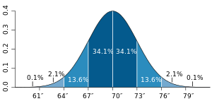
Estimated Heights of Men
Estimated probability density function of the height of adult men in the United States
Image: en.wikipedia.org/wiki/File:Visualisation_mode_median_mean.svg
Notes:
When we measure the heights of randomly selected men in the US, we find the normal distribution.
The standard deviation of this data set is 3 inches. Just over 68% of the men measured lie between 70 – 3 inches and 70 + 3 inches

Slide 103
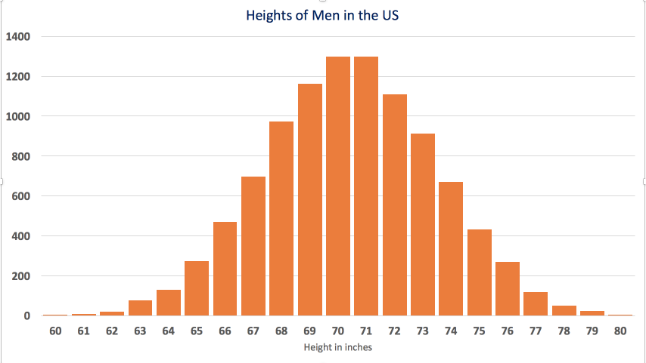
Estimated Heights of Men
Probability mass function (discrete 10,000 men)
Notes:
Here is a plot of the measurement of 10,000 men. It is discrete (countable to 10,000) but notice the shape it makes. When you measure another 10,000, you get more accurate distribution and if you take the buckets and subdivide them into decimal intervals, you will get a more continuous looking curve.

Slide 104
Normal Distribution
CLASSROOM WORK
30 minutes
Use “heights of men.xlsx” . It has real data of 10,000 heights of discrete men
Find the following
Average
Standard deviation
Plot Frequency distribution

Slide 105
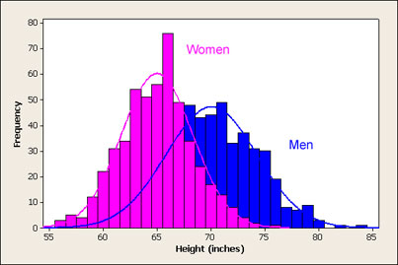
Men and Women
Men and women create two normal distros, or a bimodal distribution
Notes:
This image shows measurements made of men and women. The bars in the histogram show the actual counts of the distribution (the discrete data set) and the lines show the fit to the distribution. This is very often the case. The discrete counts match more closely the fits when the number of people measured increase. It is unknown how many were counted in this sample.

Slide 106
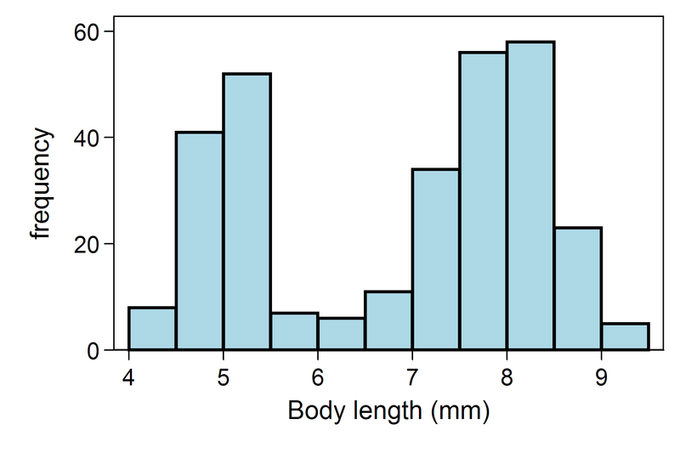
Bimodal distribution
Someone measured the body length of 300 weaver ants and got a bimodal dist as well.
Image: https://en.wikipedia.org/wiki/File:BimodalAnts.png
Notes:
This is a bimodal distribution. They are built from two different normal distributions with two different means laid on top of each other.

Slide 107
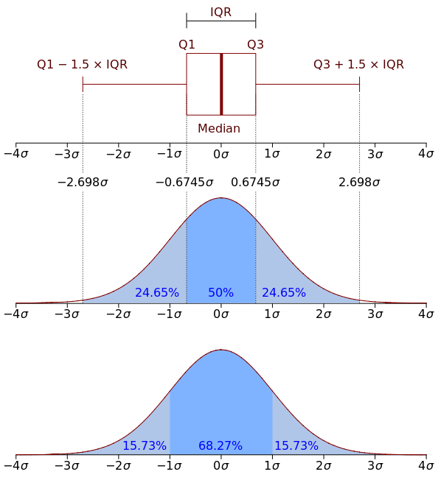
Quartiles and the Normal
Interquartile Range (IQR)
Amount of spread in the middle 50% of a dataset.
OR distance between Q3 and Q1.
Thus IQR = (Q3-Q1)
How to find Q1?
How to find Q3?
IQR from Quartiles slide
1.5 is variable value
based on field of study
Notes:
The box plot is a typical way of describing the entire distribution of a data set graphically. It shows the relationship between the quartiles, the IQR, whiskers (the outer vertical lines) and any points that may lay outside these whiskers – commonly defined as outliers.

Slide 108
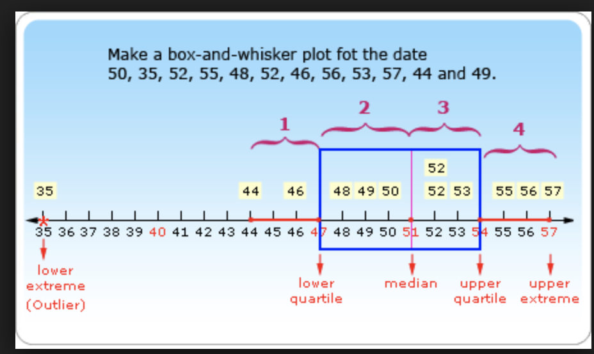
IQR and outliers
x is a moderate outlier if, x<Q1-1.5*IQR or x>Q3+1.5*IQR
x is an extreme outlier if, x<Q1-3*IQR or x>Q3+3*IQR

Slide 109
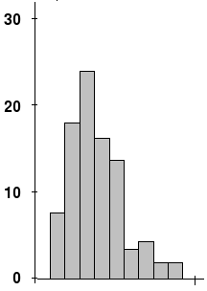
Normal but Slightly Skew
Example distribution with non-zero (positive) skewness.
Discrete variable
Long tail to the right
Image: en.wikipedia.org/wiki/File:SkewedDistribution.png
Notes:
When a normal distribution is weighted more heavily on one side, we say it has skew.

Slide 110
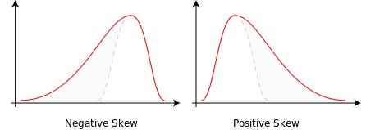
Positive vs. negative skew
Image: https://en.wikipedia.org/wiki/File:SkewedDistribution.png
Notes:
Be careful what we call positive and negative skew, it follows the tail.

Slide 111
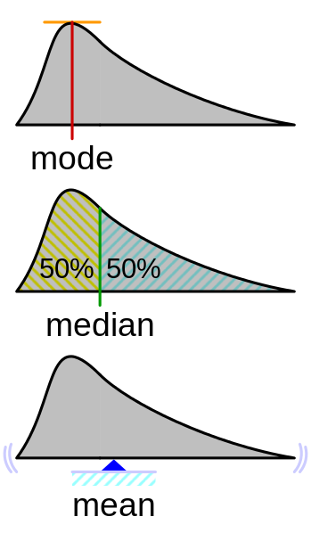
So?
Positive skew:
Mode < median < mean
Negative skew:
Mode > median > mean
https://en.wikipedia.org/wiki/Skewness
Notes:
When we have a skewed distribution, the mean, median and mode tell us something about the skew. Here we see that the mode is at the peak of the curve. The median tells us the 50/50 point and the mean is the “balance” point. The more radically skewed the distribution becomes, the more these three numbers will deviate from each other.

Slide 112
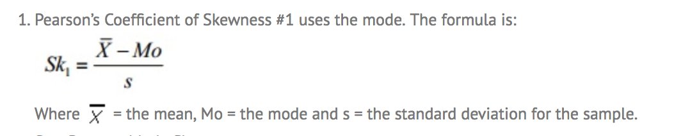
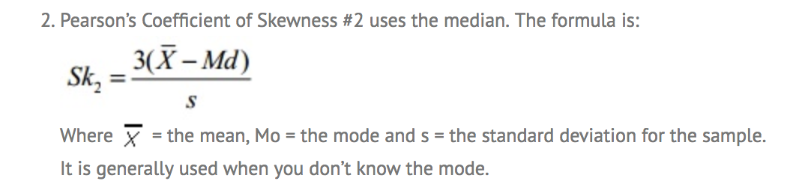
How to calculate Skewness
The direction of skewness is given by the sign.
The coefficient compares the sample distribution with a normal distribution. The larger the value, the larger the distribution differs from a normal distribution.
A value of zero means no skewness at all.
A large negative value means the distribution is negatively skewed.
A large positive value means the distribution is positively skewed.

Slide 113

Z-score
Z-score is the measure of how many standard deviation a number is from it’s distribution mean. Z-score of the center of the bell curve is zero.
In the heights of men example,
Mean = 70 inches ; STD = 3.0120
Let’s find the z-score of 78 inches.
Z-score = (78-70)/3.012 = 2.65
The Z score is a test of statistical significance that helps you decide whether or not to reject the null hypothesis. OR simply
This measure how far an observation is from the mean.

Slide 114
Other distributions
So far we discussed Normal distribution, but there are lot of others.
Why do we study distribution statistics
You want to know the data distribution and accordingly make decisions
You want to tweak your loss function as per the data distribution for any prediction
Suppose this is
Lognormal distribution,
Then you will want to choose lognormal loss function in order to converge the decision boundary
# of beds | # of baths | Sq Feet | # floor | Price

Slide 115

Binomial Distribution (Discrete)
Bernoulli Trial – ‘s’ trials are made of an event, with probability ‘p’ of success in any given trial
Binomial :- gives the discrete probability distribution of obtaining exactly ‘n’ successes out of N Bernoulli trials.
Notes:
Another type of distribution is formed from two constraints on the normal distribution. First, have positive only events (0 or above). Second, have few events. With these we see something called the Poisson distribution. The example here is a call center where we count the number of calls between 11am and noon. The average rate is low and the events are independent and we cannot have negative number of calls.

Slide 116


Poisson Distribution (Discrete)
Independent Events with a known average rate
Common Example
The number of meteorites greater than 1 meter diameter that strike Earth in a year
The number of patients arriving in an emergency room between 10 and 11 pm
Where
Lambda is the avg number of events per interval
K = number of trials 0,1,2,3,…
Notes:
Another type of distribution is formed from two constraints on the normal distribution. First, have positive only events (0 or above). Second, have few events. With these we see something called the Poisson distribution. The example here is a call center where we count the number of calls between 11am and noon. The average rate is low and the events are independent and we cannot have negative number of calls.

Slide 117


Exponential Distribution (Continuous)
Shows decaying probability
Common Example:
Time until the next call at a call center
Notes:
This is a different type of distribution altogether. It shows that fall off, or decay, as the x variable gets larger.

Slide 118

Pareto Distribution (“80/20”)
Special type of Power Law distribution
Common Examples
Wealth distribution
Size of meteorites
Notes:
The Pareto comes from a trend seen in manufacturing but applies to many things. We know it as “80% of the work takes 20% of the time and the remaining 20% of the work takes 80% of the time”.

Slide 119

Log Normal Distribution (Continuous)
Variable whose log is normal distributed
If X is Log Normal, Y=ln(X) is Normal
Common Example: (wherever there is skewed)
Amount of rainfall
Repair times
Next common to Normal

Slide 120
Distributions in Excel
Excel has many functions available to work with distributions. Using them, you can determine the likelihood of getting:
exactly a value
less than or equal to a value
greater or equal to a value
Notes:
Now that we have seen a number of distributions, let’s look at how we can use Excel to extract information out of them. What follows is a series of examples of how to use Excel formulas for the distributions.

Slide 121
Distributions in Excel
As an example, consider the normal distribution of the heights of men in the US…
We will use the normal distribution and the Excel function
NORM.DIST(x, mean ,std_dev, cumulative)
Notes:
This Excel function allows us to pass the number of interest (x) and define a normal distribution with the mean and std_dev of our choosing. The last argument tells us whether we are using less than and equal to (TRUE) or just the probability density at that point (FALSE). FALSE requires more advanced understanding of the PDF, we use TRUE throughout.

Slide 122
Distributions in Excel
What’s the probability of measuring a random man at least 67 inches
NORM.DIST(67, 70, 3, TRUE)
What’s the probability of measuring a random man at exactly 67 inches
NORM.DIST(67, 70, 3, FALSE)

Slide 123
Distributions in Excel
Normal is not the only one. Other distributions are available.
BINOM
POISSON
LOGNORM
T
CHI
Notes:
The ”1 – “ is because
All distributions sum to a probability of 1
The formula with cumulative set to true gives us “less than or equal to”. The ”greater than” part is 1 – “less than or equal to”

Slide 124
Poisson Distribution in Excel
CLASSROOM WORK
30 minutes
Use “Call Center Analysis.xlsx” . 5000 log measured for number of calls per hour.
A call center manager has decided to motivate the employees by offering a cash incentive for handling a higher call‐per‐hour at the center. In order to determine what the incentive number (calls per hour) should be.
>> The analyst needs to profile the current performance of the floor and the manager needs to evaluate the likelihood of achieving certain milestones in order to set a high bar which is still accessible by people on the floor.
1-POISSON.DIST(6,Mean,TRUE)
Find the following
Average, STDEV, Min, Max, Frequency Plot
P(calls/hour > 6)
P(calls/hour > 8)

Slide 125
Day 2

Slide 126
Fitting Data
We discuss how to fit data to data sets and discuss how these fits become our models
Section 7
Notes:
From here we are moving into basic modelling. We will look to fit math equations to data and notice what these fits can tell us. Once we know the math equations, we can make predictions about what is to come. This power is limited for a number of reasons which we will discuss along the way.

Slide 127
Bivariate Data
Scatter plots
Covariance and Correlation
Regression
R²
Notes:
The first thing we will look at is data of two variables. Our best visual aid here is often the scatter plot where we put one variable on the x axis and another on the y axis. We can look at the covariance and correlation of the data set. We use regression to calculate the mathematical fits to the data, then we look at R2 to see which is the best one. Be cautious, the literal best fit may disobey rules of the field you are working in. It is, as always important to remember that the math is not the only thing at work here. What is the problem? What is field of research?

Slide 128
Bivariate data – Scatter Plot
Bivariate – data has 2 attributes (X, Y)
Relation between X Y ?
X-Values | Y-Values
1 | 3
4 | 18
6 | 38
8 | 66
10 | 102
15 | 227
20 | 402
25 | 627

Slide 129

Covariance and Correlation
Covariance = $E[\left(X−E(X)\right)\left(Y−E(Y)\right)]$
Units are Units of X time Units of Y
Not normalized
May be hard to interpret
Correlation = $Cov/(σ\left(X\right)σ\left(Y\right))$ --- Important !!
Normalized by standard deviations
Unit less
Between -1 and 1
How X and Y are related, Corr(x,y) = 0.9 is highly correlated
Notes:
Covariance is, simply put, how the two variables vary together in the set. The formula is shown in the slide. We need it because we really want the correlation, which is the covariance divided by the std dev of both variables. Don’t worry, our tools will do this for us.

Slide 130
Correlation in Excel
EXCEL FUNCTION: =CORREL(arr1, arr2)

Slide 131

Simple Linear Regression
Finding a linear relationship which can predict the (average) value of Y for a given value of X.
Y = (mx + c)
Fit a line with given values of (X,Y), so that Y can be estimated using any value of x
Coefficient of Determination ($R^{2}$)
is the proportion of the variance in the dependent variable that is predictable from the independent variable(s).
Simply – this is the average Euclidean distance between (xi, yi) from the fitted line
Notes:
The “regression line” is a straight-line descriptor. If you have slope and y-intercept of the regression line, you can plug in a value for X and predict the average value for Y.

Slide 132

Linear Regression
Linear Relationship
Coefficient of Determination
Notes:
This fit is calculated by minimizing the sum of the squared differences between each point and the line. This amounts to minimizing the Variance of the data set (see slide on Variance). This is called the Method of Least Squares.

Slide 133
Regression in Excel
X | Y
10 | 150
5 | 90
3 | 45
15 | 200
18 | 250
How to:
Plot a scatter plot
Add a trend line (LINEAR)
Add R^2 co-efficient
CORREL | 0.978669933
Observation:-
X and Y are monotonic increasing function that can be verified by the equation on the chart
Corr(X, Y) is very high

Slide 134

R^2
Squared sum of vertical distance between the points and the fitted line
Higher the value, better the fit is
Square_Root{
(d1^2 + d2^2 + … + dn^2)
} / n

Slide 135
Linear Regression
Beware: Some people try to “force” a linear relationship where one does not exist. Plotting linear regression is only a valid tool IF:
The scatterplot forms a linear pattern (you must use a scatterplot to detect a linear relationship in the first place)
The correlation, r, is moderate to strong (typically beyond 0.50 or –0.50).
Notes:
These are some warnings about curve fitting. One note about the moderate values of r… in the real world, r = 0.5 is not enough for a good correlation.

Slide 136
Other Fitting Functions
Linear – y = mx + b
Polynomial - y = a + b*x + c*x² + …
Power Law - y = a*x^{b}
Exponential – y = a*b^{x} (a*e^{x})
Sinusoidal – y = a*sin(b*x + c)
Logarithmic, etc.
Notes:
Linear regression is a technique and we can fit a lot of different functions with it. Some of the function types are listed above.

Slide 137

Linear Fit
Simplest fitting
Everything is linear if inspected closely enough
m is the slope; b is the y-intercept
$$y=mx+b$$
Notes:
The simplest is the straight line. The equation of the line, when you show it in Excel looks like the equation here, except m and b will be numbers determined by the fit.

Slide 138
Linear Fit
y = mx + b
m = 12.59
b = 21.775
Notes:
This is what Excel will display.

Slide 139

Polynomial Fit
Can fit anything with enough parameters
Be careful with extrapolation
$$y=a+bx+cx^{2}+dx^{3}…$$
Notes:
A polynomial is an equation with higher powers of the x variable (the independent one). Be very careful with this… you can almost always fit any data set perfectly by going to enough powers of x, but it does not mean that you are correct. Certain fields of study obey know laws or trends and these determine the type of equation you should use. A bad fit of the data to this equation could mean you have bad data, not require higher order fits. You, as the analyst, should know as much as you can about the field to determine these things.

Slide 140

Polynomial Fit
Fit with order 2
Parabolic
Notes:
This is an example of a parabola. This is really common in studying new materials in physics and engineering. Notice the equation has a squared x term in it.

Slide 141

Power-Law Fit
Income counts histogram
Frequency of words in Text
$$y=Ax^{B}$$
Notes:
The power law is a fit where B is some number (2,3,4,5,6,etc).

Slide 142

Power Law Fit
Power Law
B = -0.7
Notes:
Here is one where B is negative and a fraction.

Slide 143

Exponential Fit
Continuously Compounded Interest
Radioactive Decay (Half-life)
Amount of a drug in the blood
$$y=Ae^{Bx}$$
Notes:
The exponential fit is a common fit to data such as the examples stated.

Slide 144

Exponential Fit
Exponential
Perfect Fit
Notes:
Continuously compounded interested? This is how much money I owe?!

Slide 145
Data Fitting
Choosing which fitting function to use should be based on an underlying understanding of the data.
Extrapolation beyond the bounds of the data must be done with care.
Notes:
Remember, choosing the fitting function is more than just trying the functions until one gets a high R2 value. It is a powerful tool, but you are fitting things that have already happened. Be careful about predictions you make from it.
INSTRUCTOR NOTE
We have cover simple curve fitting and linear regression for analysis. The students should be made aware that there are a variety of regression techniques which we do not cover.
Logistic
Stepwise
Ridge
Bayesian
just to name a few.
The instructor can investigate these quickly by a quick perusal of the Wikipedia articles on them. Rigorous approaches are left to other courses.

Slide 146
Data Fitting in Excel
CLASSROOM WORK
45 minutes
Use “Customer Retention.xlsx”
Plot scatter plot
Add trendline – Linear, polynomial, exponential
Check whose R^2 is least
determine what kind of fit is best
Repeat the same process for “Candy factory.xlsx”, “Nurf Foam Factory.xlsx”

Slide 147
Data Fitting in Excel
DISCUSSION
15 minutes
“Customer Retention.xlsx” – Should be exponential
“Candy Factory.xlsx” – Should be linear
“Nurf Foam Factory.xlsx” – Should be Polynomial

Slide 148
Cluster Analysis
We look at another way of drawing conclusions from visual data
Section 8
Notes:
Let’s look at a different way to visualize data. It still involves scatter plots, but the analysis is different than simply looking at a data fit.

Slide 149
Clustering
Finding common groupings in a multi-dimensional dataset (segmentation)
Can be used to find patterns that are difficult to identify by eye
Major factor in machine learning
Notes:
Clustering is where we apply a number of algorithms to find patterns in multidimensional data sets. These patterns are instrumental in machine learning. Remember that we mentioned credit card fraud some time ago in the course, well, that type of analysis is a major clustering and pattern recognition algorithm in which analysts look for patterns and anomalies from the those patterns.

Slide 150


Cholera in London
An early example of clustering
John Snow found the cause of an outbreak and help prove the germ theory of disease
https://www1.udel.edu/johnmack/frec682/cholera/cholera2.html
Notes:
In one of the most famous cases of pattern recognition from clustering analysis, a doctor in 1850’s London stopped a deadly disease and at the same time proved the germ theory of disease.
John Snow investigated the cause of a cholera outbreak by documenting where the cases were located. Discovered that people who lived near, or travelled by, the Broad St. water pump were much more likely to get cholera. A nearby cesspool had leaked in to the water supply.
Left – Snows original map of cholera cases in London
Right – Cases shown in red, Water pumps shown in blue.
From: https://www1.udel.edu/johnmack/frec682/cholera/cholera2.html

Slide 151

Voronoi Diagrams
Show the group of points that are closest to certain centers
Centers can be chosen by hand, or determined by and algorithm (e.g. K-means)
https://en.wikipedia.org/wiki/Voronoi_diagram
Notes:
A Voronoi diagram provides a visual map of the distance of any point in space to a specified center point in a region. That center point is usually the mean of a cluster, though it could also be something called a medioid. The regions in the map above show areas in a color in which all points in that color area are closer to the black dot in that same color area than they are to any other black dot. This has been applied to John Snow’s map and the computers arrive at the same conclusion he did about the source of the epidemic. Today, these algorithms can tell ambulances the location of the closest hospital in real time, and many other things.

Slide 152


K-Means
Algorithm that iteratively moves center points to define clusters
Initial centers are either chosen or placed randomly
Notes:
These charts are 2-D examples from R with 2 or 5 centers. The K-Means algorithm works in iterations. It calculates distances from a chosen “center”, then moves the ”center” then calculates distances again, over and over, until the next iteration does not improve the accuracy any. At that point, in K-Means, you have the mean values of clustered data sets.

Slide 153
Monte Carlo
We discuss a few things that take us into advanced prediction
Section 9
Notes:
Up to this point in the class, we have been looking at modelling data for explanatory power, but with limited predictive potential. There are many methods by which we try to add prediction to descriptive data and we have chosen to look at a common one with a simple fundamental premise – Monte Carlo.

Slide 154
Monte Carlo Method
Random Inputs into Models to Sample possible Outcomes
Works on models that are too complicated to calculate analytically
Used routinely in Business, Finance, Science, and elsewhere
Notes:
The idea behind Monte Carlo is that if you play games of chance long enough, probability defines how often you will win or lose. The only unknown, really, is the model of the game you are playing. In the case of black jack, you are looking to add to 21 given the cards in a deck and the players in the game. Of course, you can never know for sure how one game will end up, but you can calculate the likelihood that you will win any game, and play enough games, you will win that many times.
In Monte Carlo, we develop a model of our system and we use computers to ”play a game” with that model over and over again. We generate random inputs and send them into the model. Then we keep track of what these results are and start adding and subtracting, multiplying and dividing to “ask the questions” of the results. Don’t worry, we will keep out models simple, but in the real world, the power comes from developing complex models and letting probability and powerful computers find our answers.

Slide 155
Monte Carlo Method
How does it work?
Build a model
Use a random number generator (RAND() in Excel) for input to the model
Do this thousands, if not millions, of times to build a probability density function
Query the PDF to find answers to questions
Notes:
Here is a brief description of the steps involved. Note that here, PDF is the probability density function from the distribution of results, not the document format.
The next series of slides shows how to do it in Excel.

Slide 156

Monte Carlo Method
Data set is 300 previous jobs from DB records
Analysis shows
Average = 20 days
Standard Dev. = 3 days
Distribution = Normal
Notes:
The data set is 300 records, only some of which are pictured here. The first step is to analyze the data with the basics: Average, Std. Dev. and plotting the distribution.

Slide 157

Monte Carlo
Make call to RAND()
Fill in the Average from
the data analysis
Fill in the Std Dev from
the data analysis

Slide 158

Monte Carlo
Use these values in the model

Slide 159

Monte Carlo
Build a simulation table and
reference the model

Slide 160

Monte Carlo
Create a What If?
Data Table
Notes:
To create a What If? table, you need to click on an ”off, empty cell” for the column input cell

Slide 161

Monte Carlo
Now there are 10 independent
trials which we can use as a distribution
Notes:
In reality, this only works when we have many more trials (thousands, if not millions).

Slide 162

Monte Carlo
Query the results by finding relative frequencies
Using COUNTIF() and a Named Range
Notes:
It is important to remember (cannot be stressed enough) that these numbers are not valid with 10 trials. The relative frequencies will converge as the number of trials grows very large.

Slide 163
R Programming
We go back over the class material, this time in R
Section 10
Notes:
Programming… this might scare you a little, but that is ok, we will not be doing much actual programming. This is more a section to motivate you to go beyond Excel. A real R programming course will take a substantial amount of time to cover.

Slide 164
What is R?
R is a programming language for
Statistical Computing
Data Analysis
Data Charting
Data Modelling
Notes:
R is open source and freely downloadable from https://www.r-project.org/
We recommend R Studio to develop your code in, it is just easier to manage. It can be found at https://www.rstudio.com/

Slide 165

R Studio
Data Window
Multipane
Console Window
Notes:
This is a screenshot of R Studio. It is a development environment for code where commands are executed in the console window, data is available in the data window, and the multipane window shows help, charts, and a number of other information displays.

Slide 166

Basic Analysis in R
Import Grades
Give data set a name
Will access with heading as variable
Notes:
In R Studio, you can import data from a variety of sources – Excel files, CSV files and Tab delimited text files to name a few.
Here we are pulling in grade data from one of the CSV files in the labs.

Slide 167

Basic Analysis in R
Convert scores to percentages
Converts all elements in data set at once
Notes:
This takes every row of data in the Score directory, divides each value by 20 and multiplies by 100, turning the value into a percentage. The arrow says to store the result of this calculation in a variable called outOf100.

Slide 168

Basic Analysis in R
Calculate central tendency
Ask for help
Plot histogram

Slide 169

Basic Analysis in R
Notes:
This is the result of the hist() command. It is basic, but R does have a lot of options for setting parameters like labels and ticks. Consult the documentation for more information.

Slide 170

Basic Analysis in R
Create a boxplot with boxplot(GB$Scores)

Slide 171

Basic Analysis in R
A different set has an outlier

Slide 172

Monte Carlo in R
Create a function
Call the function multiple ways
Note operations on arrays as variables
Notes:
This is a shot of the console window to create a function in R. Functions are ways to create reusable pieces of code.

Slide 173
R Summary
Open-source, well-supported tool for data analysis
Often more efficient than Excel for repetitive tasks
Numerous packages are available for complicated analysis techniques and data visualization

Slide 174
Data Visualization
We talk about how to tell the story
Section 11
Notes:
Hopefully, you have seen a number of ways to create data visualization by now, but to end the course lets talk about the final aspect of analysis, telling people about it.

Slide 175

Time to Tell the Story
Notes:
After all the hard work , you have to communicate the results. Results are not just numbers, but also conclusions. You have to tell your story from problem definition to conclusion at multiple levels depending on who is listening.

Slide 176
A Few Simple Rules Go a Long Way
Remember what you’re accomplishing
Really know your user
Keep it simple
Use space judiciously
Focus on the design as much as the data
Notes:
A story has a beginning, middle, end, a plot, and hopefully, a reader. Telling your story is no different.
What problem were you attacking?
Why were you taking it on?
What did you do to solve it?
What assumptions, what data was used, rejected?
What was the conclusion?
And as for the reader, what level of depth do they require to ”get it”?

Slide 177
THE GOAL OF VISUALIZATION
What you’re really trying to accomplish
Efficiently communicate the right information to the right person
Tell the story
Critical Characteristics
Has a Beginning, Middle, End
Has a punchline
Doesn’t lose the reader (stakeholder)
Enable better decision making
Notes:
People see patterns very well. We create them where there is nothing a lot of the time (shapes of clouds for instance). Presenting data is leading people to the pattern and telling them the information necessary – not all the information. Charting is great for this. Tables of numbers don’t work so well for most people. This is why we call is visualization.

Slide 178
Two Tales of The Same Information
Common go-to Object
“Bolder,” more efficient choice
Notes:
Here are two objects to display information. Which of the two looks “better”? Conveys information more effectively? Which one requires less eye movement and cognitive engagement to extract the information?
Hint: Pie charts are usually frowned upon in any scenario.

Slide 179
KNOW THE USER
Understand what types of decisions are being made
Timeliness of decisions affects design
Exception vs. Total Picture
Some people like more numbers
…but you can still help them be more efficient
Notes:
Knowing the user is critical. The project leader needs details, the CEO, not so much, they need broad strokes.

Slide 180

Stakeholder Cheat Sheets*
*Exceptions will apply
THE VERIFIER
BEST BETS
Likes Detail
Tends to Question
Methodical
The Planner
Resists Change
Notes:
These are quick reference slides to stakeholders and what they may like to see. Think about any organization you have been in and see if you agree and can match the personality type with the layout design.

Slide 181

Stakeholder Cheat Sheets*
*Exceptions will apply
THE BIG THINKER
BEST BET
Shuts Down with Detail
Tends to trust
Moves first, Plans In-Route
Thrives on Change

Slide 182
Stakeholder Cheat Sheets*
*Exceptions will apply
THE INTERPRETER
BEST BETS
Moves quickly to change
Stops to question logic
Diverse
Wants enough detail to feel comfortable

Slide 183
Common Presentation Missteps
Data chucking
Overly graphic
Lack of graphical insight
“Just get it out” mentality
Lacking clear message
Notes:
Avoids these when performing the analysis and preparing the presentation. Don’t discard data that are outliers. They are important to indicate the outliers. Don’t show graphs just to show graphs, concentrate on displaying the insights. All of the presentation should serve the message.

Slide 184
Choosing the Format
Based on Context
High-level, At-a-glance = Dashboard
Middle-level, Summarized = Report
Low-level, Aggregation-ready = Excel
Based on Usage
Strategic Direction = Report
Tactical Course = Dashboard/Report
Analysis/Collaboration = Excel

Slide 185
Reports
Mix of Graphs and Tabular
Snapshot (cached)
Interactive
Drill-down
Filter
Slice
Single purpose
Easier to create

Slide 186
Dashboards
Best are purely Graphical
Often real-time or close to real-time
Some Interactive
Drill to detail
Some filtering
Can be multi-use
Harder to get right

Slide 187
Excel
Detail data
Give a push with PivotTable or Chart
Best include Dynamic Data

Slide 188
KEEP IT SIMPLE
Ask yourself the question: “Will my user ‘get it’ in less than 5 seconds?”
Classic chart types are classics for a reason
Don’t go crazy with color
Take a minimalist attitude
Remember the goal

Slide 189
Which Graph Conveys Information Better?
Notes:
There is no right answer, there is a good answer for the purposes. In this case, the level of detail desired is the key.

Slide 190
USE SPACE JUDICIOUSLY
Reduce noise
Continually ask, “How can I make it cleaner?”
If it doesn’t help tell the story, it’s out

Slide 191
Zebras Don’t Belong in Graphs
Notes:
The message here is a little subtle, but horizontal lines to tell you the numbers when the numbers are on the vertical bars. Clean it up and the picture is more pleasing with less distraction.

Slide 192


Grid-based can be more challenging
Notes:
Tables are hard to use to deliver data effectively. However, it is clear, we hope, that the multi colored cells to serve as indicators is a visual onslaught. The bottom table shows how to clean up a table for better, more pleasing display.

Slide 193
FOCUS ON DESIGN
Color palette matters
Go for a clean look
Don’t clutter with icons and FAQ
Drill-down versus “Kitchen Sink” approach
Not all screen locations are created equal
Reduce or eliminate non-essential features
Be consistent

Slide 194

An Example of Poor Design
Notes:
Everything here is meant to offend the eyes, it seems.

Slide 195

Good Design Techniques Applied
Notes:
This is complicated but clean.

Slide 196
Some Final Thoughts…
Mock up in Excel first
Design for the long-run
Fight the temptation to use flashy graphs
Constantly edit down to the basics
Mix Qualitative and Quantitative for maximum impact

Slide 197
Course Evaluation
Please take a moment to complete your course evaluation
Go to http://www.metricsthatmatter.com/ASPE
Choose the class name listed with the date of the class and your instructor’s name
Fill out and submit the form
It is available for 10 calendar days
Thank You!

Slide 198
The End of the Show
We take a deep breath and relax before we go and analyze data

